Slide 1
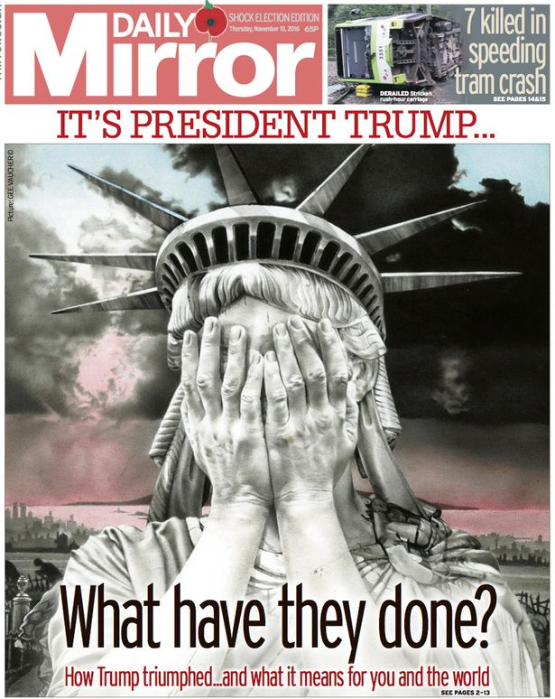
The Daily Mirror
Eloise Heasman-Ames

Slide 2

Industry context
The Daily Mirror often employs intertextuality and popular cultural images to better establish a connection to its largely “mainstream” w/c readership, often repackaged as parody. It assumes that it’s audience are media “savvy” and are well versed in aspects of popular culture enough to recognise irony and sarcasm and often uses references to these other texts to exploit its own political and social agenda. Throughout its history the Daily Mirror has often employed Television and radio adverts broadcast during prime-time slots to further boost sales of their publication, consistently branding itself as the “fun and youth orientated” alternative to the staid and stuffy news dissemination of its broadsheet competitors. The Daily Mirror has employed a series of promotions and competitions within its pages to offer the readership a more inclusive and appreciable relationship with its writers, editors and owners.

Slide 3
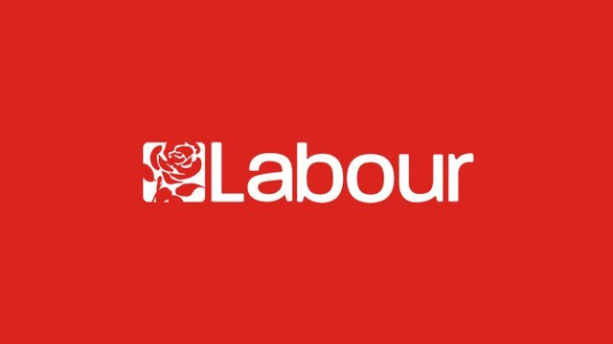
Product context
The Daily Mirror is a British national mid market “Red-Top” daily Tabloid Newspaper established in 1903 and aimed at a predominantly w/c readership, it follows a traditionally left wing political stance. Many stories often written in a subjective manner promoting left wing values and strong associations to the British Labour Party, especially during General Elections whilst firmly supporting Britain’s exit from the EU. The Daily Mirror strongly support unionised rights for workers, are anti austerity and pro public funded service systems. This edition was published on March 13th, 2019, after Theresa May had encountered another Commons defeat over her Brexit proposals. As a mostly left-wing newspaper, the Mirror has been critical of the way the conservative govt. has been handling the Brexit negotiations. The Daily Mirror demonstrated an unequivocally oppositional response to Theresa May’s Brexit defeats in the House of Commons – and continued to portray her leadership of the Conservative Party until she subsequently stepped down months later where the political focus was somewhat replaced by the emerging search for the new Tory leader and the ensuing appointment of new PM – Boris Johnson. The Daily Mirror now markets itself as the “intelligent tabloid” claiming to offer thought provoking exclusive stories for the masses, supported by the branded twitter hashtag “#madeuthink”.

Slide 4
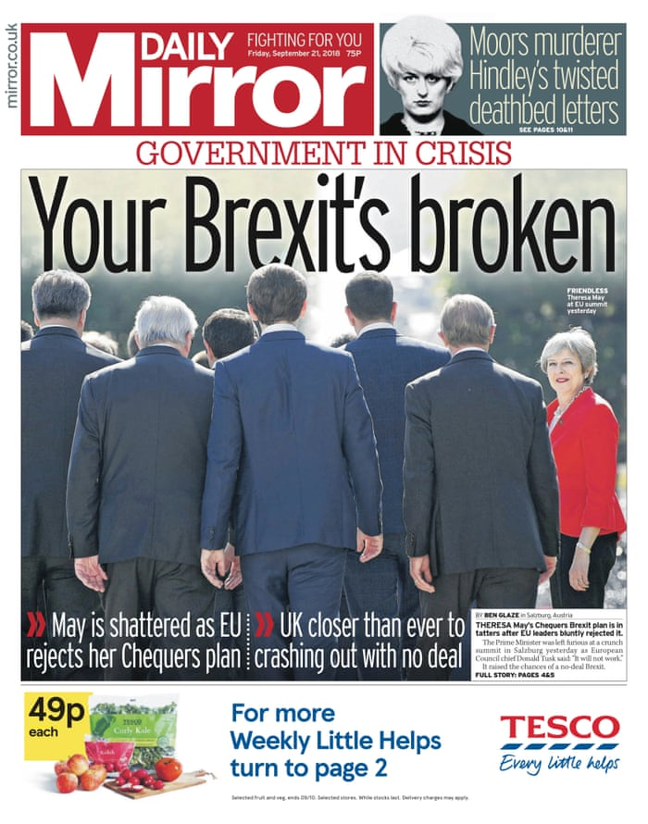
Political context
On 23rd of June 2016, citizens of the UK voted to leave the EU. It was named nicknamed “Brexit”. The vote was very close with 51.9% voting to leave and 48.1% voting remain. The controversies from the campaign continued even after the vote. Remainers accused leave voters of xenophobia and racism; leavers accused Remainers of being unpatriotic and un-democratic. The period since the referendum has been one of political turmoil. Following the resignation of David Cameron shortly after the vote, Theresa May has faced regular leadership challenges from within her own party, and a snap general election in 2017 in which her party suffered heavy losses. Meanwhile, May had been regularly visiting Brussels and EU countries in an effort to create a Brexit deal that would satisfy both the EU and the UK parliament, MPs had voted against the deal Theresa may had negotiated with the EU. This was very serious as the UK was scheduled to be leaving the EU ten days after. Withdrawing from the EU with “no deal” could have catastrophic consequences on trade, immigration, healthcare etc., affecting all UK citizens. The daily mirror consequently have challenging views on the leadership of the conservative party.

Slide 5
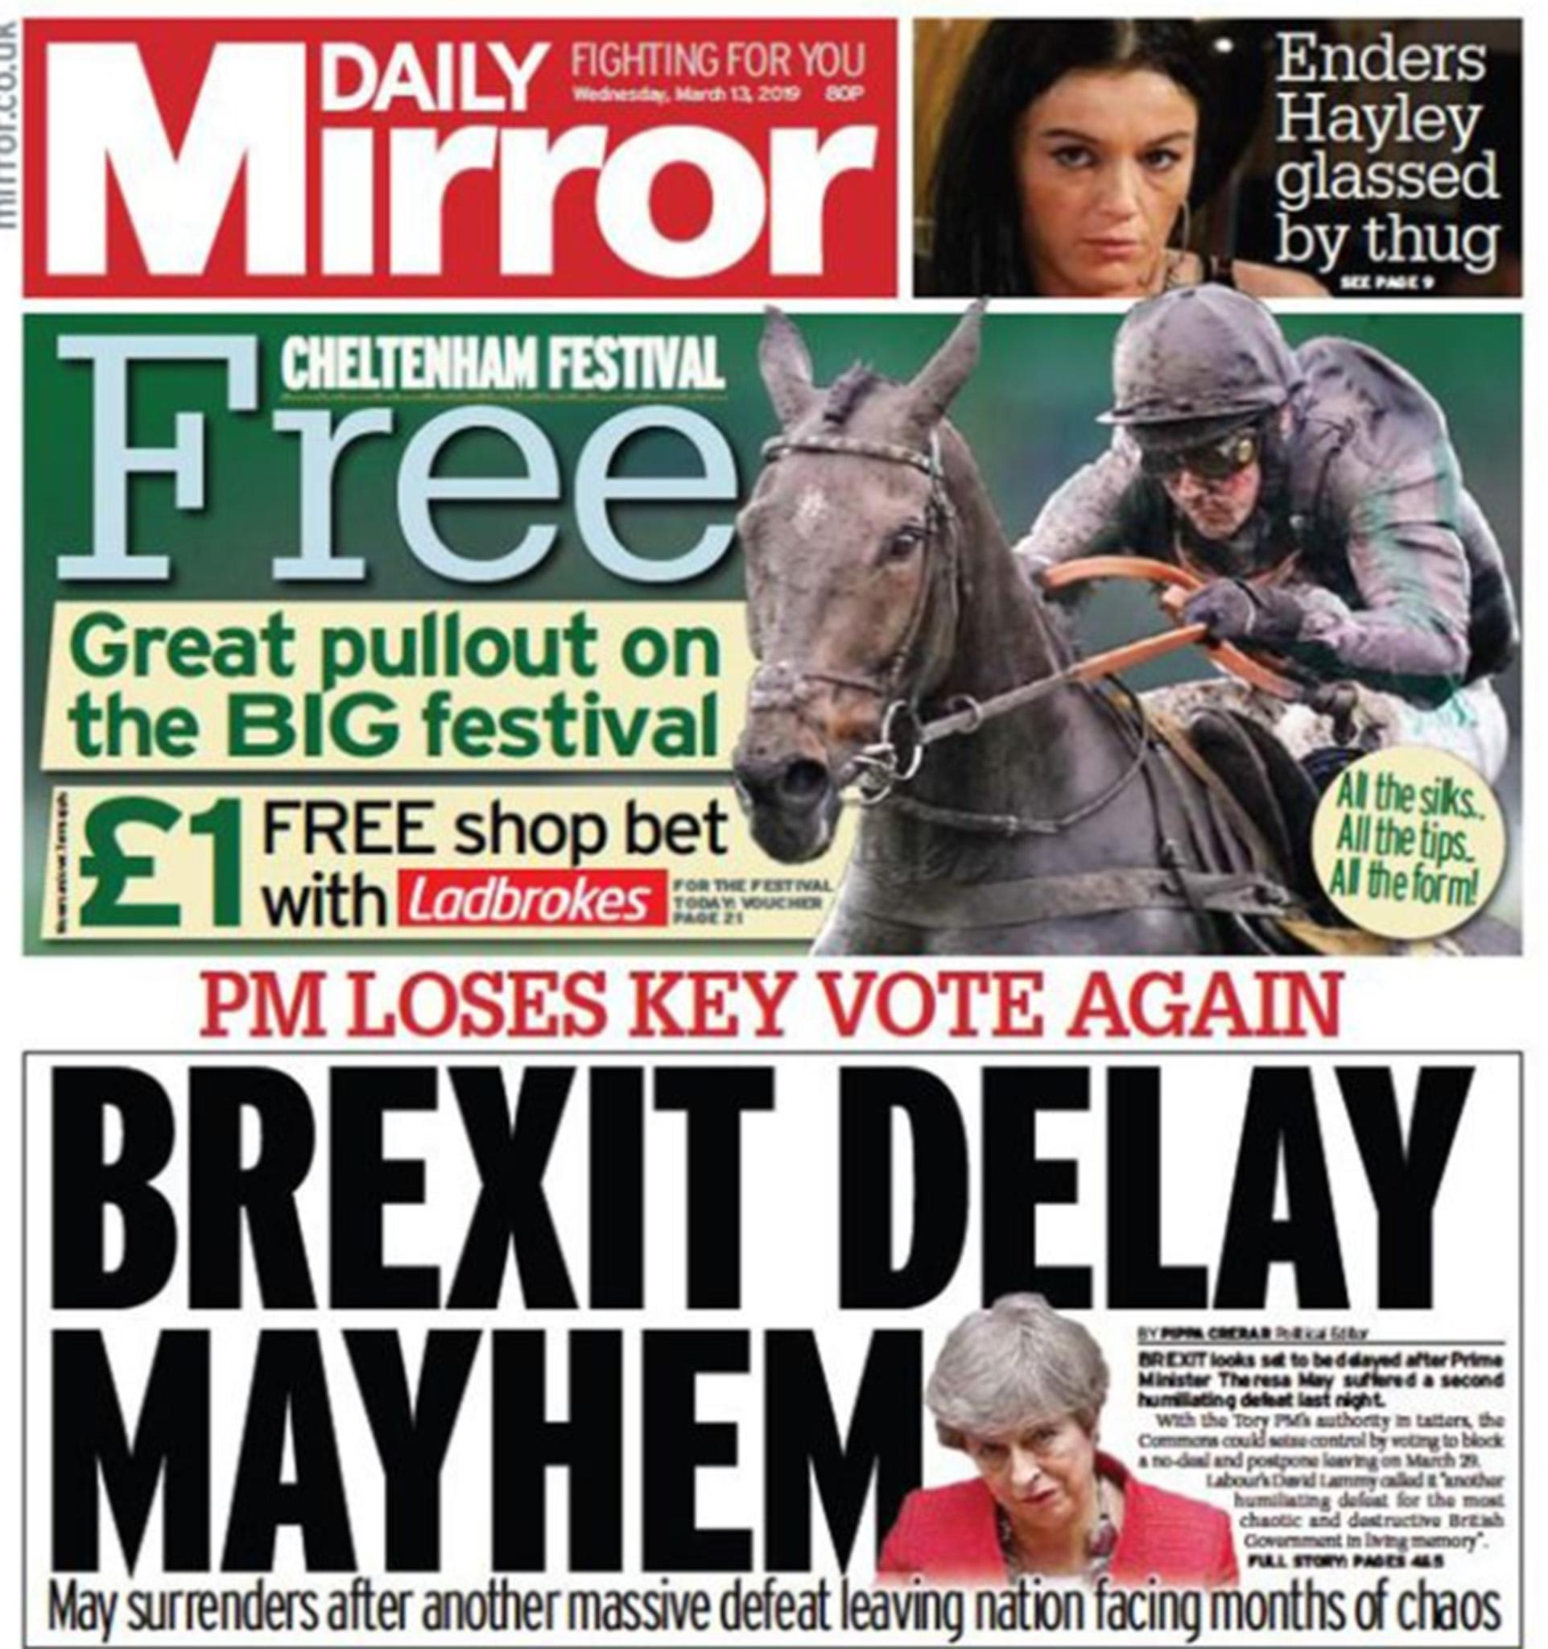
Cultural context
Eastenders is one of the UK’s most popular soap operas, with a reputation for featuring hard-hitting storylines that often feature issues such as rape, domestic violence and homophobia. Since 1985, it has been regularly watched by audiences of up to 20 million people. This has turned the actors into celebrities and tabloid newspapers often run stories about the actor’s lives mirroring their Eastenders’ storylines. Traditionally, one of the Mirror’s man elements is sports reporting. The “back pages” often feature the betting odds for horse races and will have special “pull out” features when there is a major racing event. Racing “meets” like Ascot and Cheltenham have upper class associations, but have increasingly become more popular days out for the less wealthy audiences.

Slide 6
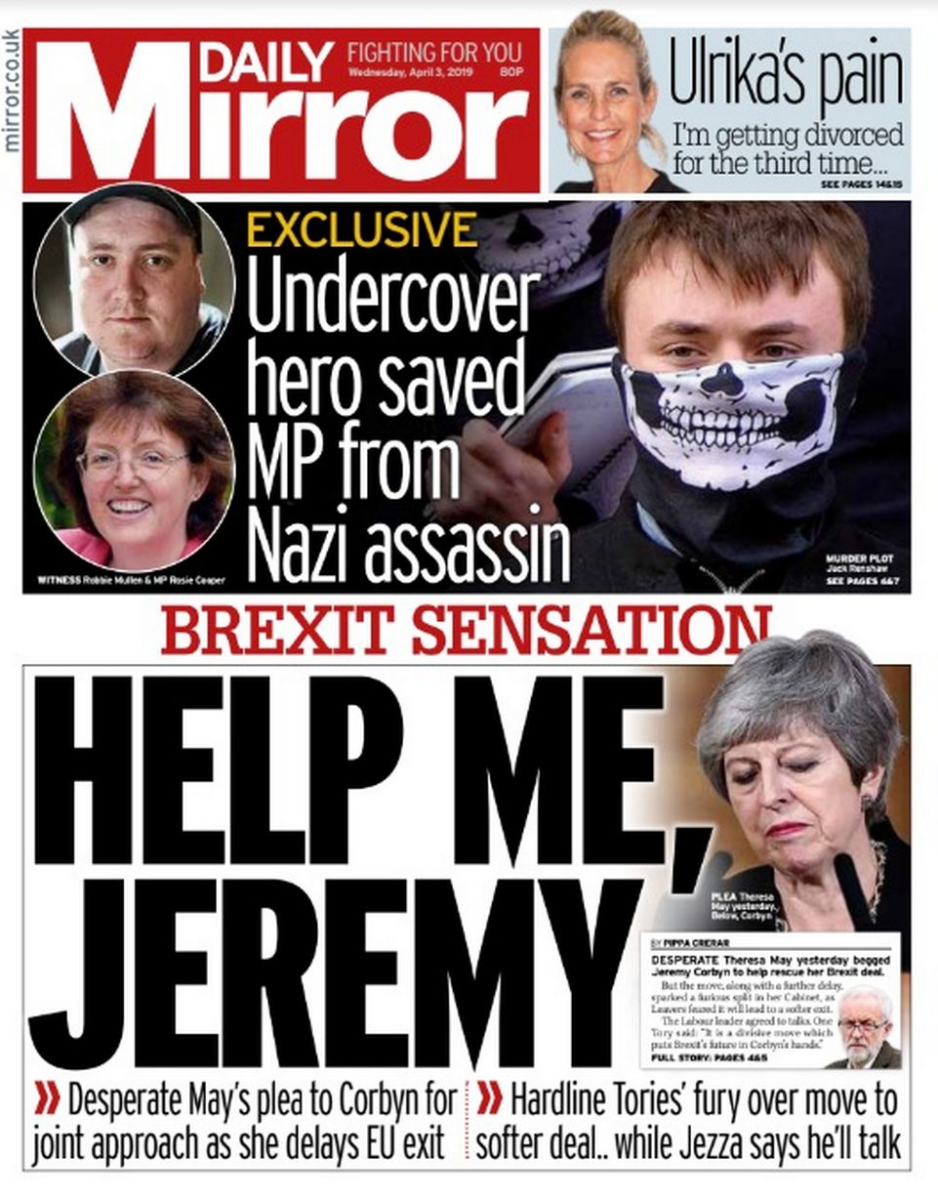
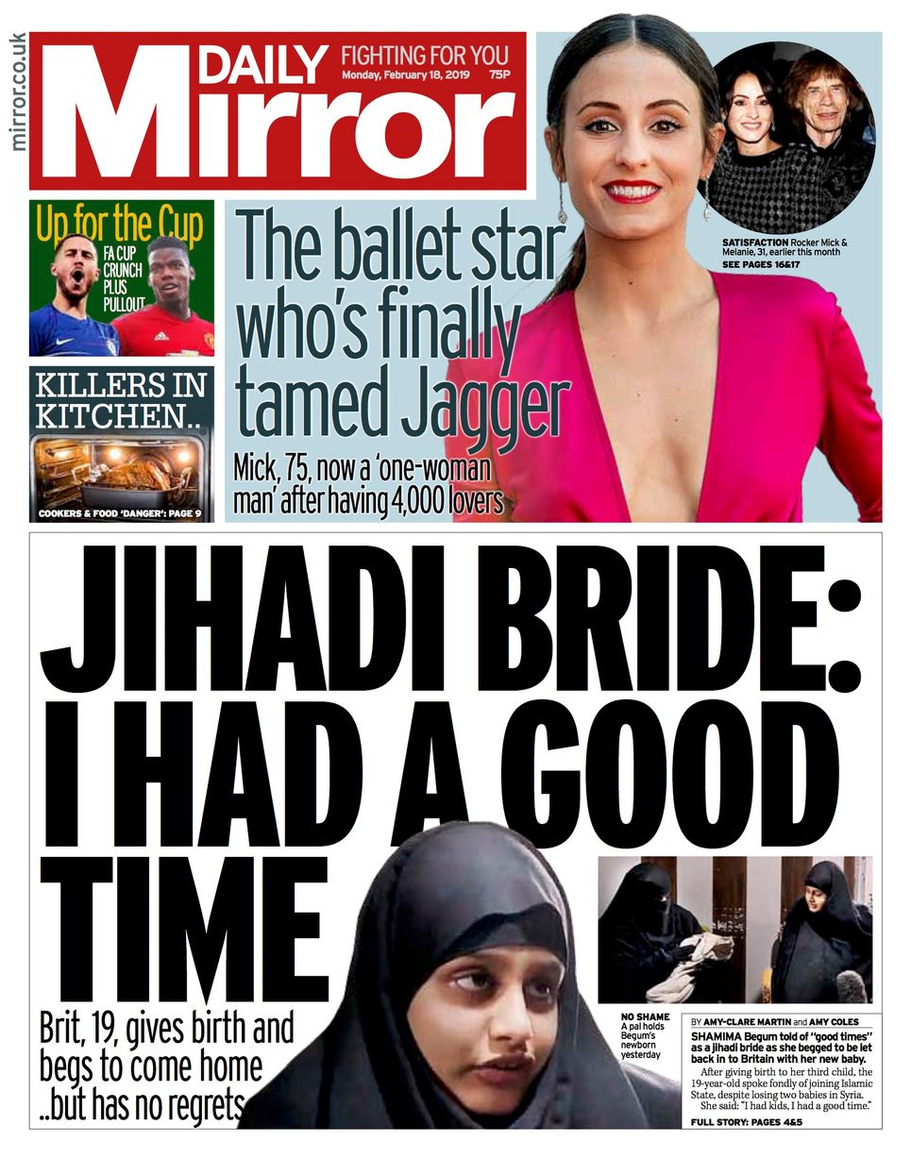
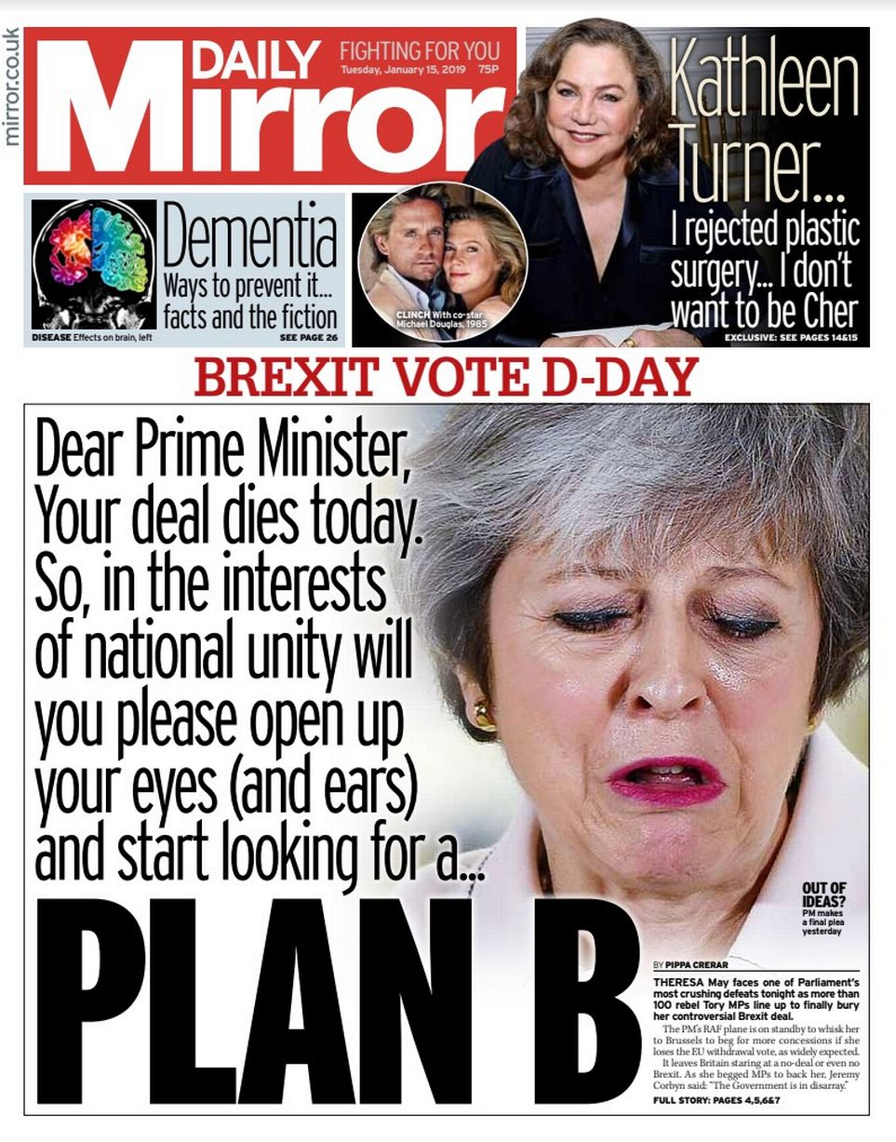
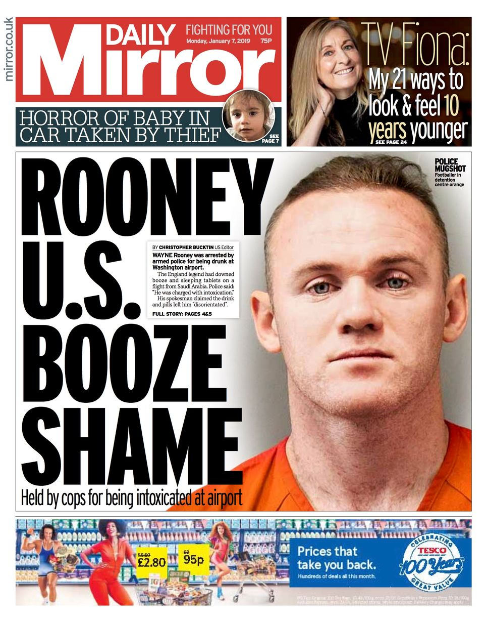
MEDIA LANGUAGE – Codes and conventions
The contemporary audience could be assumed to be familiar with the codes and conventions of tabloid newspapers and the sensationalised mode of address that these newspapers present.
The Codes and Conventions of Tabloids consist of elements which promote popularity over story content through: bold layout and colloquial language, shorter articles, puns and jokes in headlines, use of hyperbole, focus on human stories and celebrity gossip, use of gimmicks to attract readers

Slide 7
MEDIA LANGUAGE – Front Page
The page is split between the political story, a “puff box” promoting the pull-out supplement, and an advert for a betting service. The headline “Brexit Delay Mayhem” and the use of the emotive words “surrender”, “defeat” and “chaos” suggest the negotiations for Britain leaving the EU are disastrous, whilst also subtly criticising the strength of Theresa May’s Political leadership of the country.
The image of May looking very serious anchors the headline - the fact that the image is tiny reinforces how little respect or faith the Mirror has in May’s abilities.
The strapline “Fighting for you” provides solidarity for people confused or worried about the political turmoil of Brexit.
The Cheltenham Festival pull-out actually dominates the page – with bright green font and background, combined with an exciting action shot of a horse and rider, it grabs the attention more than the political story, conveying that it is almost more important than politics.
The puff box “All the tips! All the form!” offers practical betting advice and the offer of a free bet will also entice the reader. The use of these terms positions the reader as someone already knowledgeable about racing.
The adverts at the base of the page also uses brightly coloured graphics, the greens linking it to the racing feature above.
The article about the assault on the actor is a close-up of her upset face, to create empathy and the reader feel closer to this “character”; thus humanising the story teased by the jump line to the appropriate page inside. The headline uses emotive slang like “glassed” and “thug” to condemn the attack. It also doesn’t use the real actor’s name instead addressing her as her character’s name. The abbreviation of Eastenders along with the slang suggests this story is less important and more “gossipy”.

Slide 8
MEDIA LANGUAGE – Double Page Spread Article
The central image is a medium shot of Theresa May: her hands are raised which could connote defeat or exasperation at her (and the government’s) predicament. It could also, on the other hand indicate conciliation or resistance.
The text of the article shows it’s a mixture of all of these. May is portrayed as someone who is losing, but who is also bravely fighting on against the odds.
The use of the Pull-Quote framed in red and shaped like a ripped out page from a calendar to legitimise the opinion of the Mirror framing Theresa May as potentially “useless” in the negotiation of such an important deal.
The language of the whole article is allegorical: portraying the debate in Parliament as if it is a horse race. “A Faller At The 2nd” is racing track slang for a poorly performing horse, and there’s even an over exaggerated book keeper character at the bottom of the page, offering odds for the different Brexit outcomes. This also links to the positioning and language used in the front page.
Throughout the main article, May is described using light hearted derogatory language. Though her “dwindling authority” is ridiculed, at some points her efforts sound almost heroic in light of her thankless task.
On either side of the double page there are two rival columns offering opposing viewpoints on the proceedings. The style of these is similar to that of sports journalism.
There are also numerous light-hearted movie related pop culture references.

Slide 9
MEDIA LANGUAGE – Theoretical Approaches
Semiotics – Roland Barthes: The colour of Theresa May’s dress on both the front pages and double Page Spread could suggest multiple polysemic connotations – it could reflect the danger that Brexit may promise to fulfil or May’s resolute and untarnished passion for politics despite her gruelling ordeal relating to Brexit of late. Theresa May’s gesture codes as featured in the double page spread image is one of tired resignation – her raised hands connoting surrender reinforced by her genuinely tired and sad facial expression.
Structuralism – Levi Strauss: There’s binary opposition between the MPs and “the Nation” which feeds into the “us vs them” ideology of “populism”, and therefore further establishes a possible disconnect between the two, suggesting the leaders of the country are somewhat “out of touch” with the popular consensus of the general public. There is also an opposition between the two political pundits on the doble page piece, emphasised by the presence of Jeremy Corbyn and Boris Johnson. The language in the headlines also explains some quite complex political debates in using the allegory of a horse race – this dramatizes the details.

Slide 10
Theoretical Approaches cont’d
Hermeneutic Coding – Roland Barthes: Enigma code is created via the scenario that May’s latest vote has been unsuccessful – further throwing the country into “mayhem” and therefore as consequence posing the hypothetical question of “what next?” as the way in which the PM’s leadership is constructed would suggest that not even the politicians know the answer to this quandary.
Post Modernism – Baudrillard: Presence of simulacra in the ongoing portrayal of the disastrous negotiations over a “no deal Brexit” for the UK, since the vote was originally cast under David Cameron. The fact that the negotiations themselves have become something of an ongoing “joke” amongst certain media formats . Openly parodied in satirical current affairs TV programmes and recreated in TV Dramas. To an extent Brexit itself has often been cited as narcotising the news media consumers – as many have become desensitised of talk of “disastrous effects for the UK”.
News Values – Harcup and O’Neill: The UK Brexit debate addresses multiple news values important for “newsworthy” stories within UK Newspapers.

Slide 11
REPRESENTATION – Front Page
By reducing Theresa May to the smallest image on the page, the Mirror is sending a clear message about the way she is seen by her fellow MPs and by the newspaper’s target audience, she is seen as inferior.
The headline focuses on her defeat and implies the whole situation is her fault – there is very little description of the MPs who have challenged her, nor in any way trying to spread the blame on any other number of possible factors.
This personalises a complex story by making it about the experiences of one individual rather than a complicated political progress involving hundreds of people. This is a technique used by news media to help audiences build emotional engagement about “dry” political or economic stories. As the audience of the Daily Mirror may struggle with the intricacies of political discourse, this technique is used to overly-simplify something which is inevitably much more complex.
The small amount of space given to the whole story – along with the “…Loses Key Vote Again” headline – suggests that, these political conflicts have become almost commonplace, and this is all part of the ongoing Brexit “chaos”.
Both this and the Eastenders story could suggest women are weak and vulnerable. The Mirror has an even gender split in their audience, which may explain this is more complex portrayal of women in other.

Slide 12
REPRESENTATION – Double Page Spread Article
The portrayal of May as embattled continues wit a blow by blow account of the debate. The detail of her losing her voice again represents her as both weak, but also relentless in her aims.
The image of her dominates the page, whilst the male politicians are in far smaller photo-boxes. There is a sense that even though she is failing, she is going down fighting. Though this seems at odds with the Mirror’s political bias, it does fit with the large female market who may admire May’s tenacity even if they don’t like her politics.
She is clearly portrayed on these pages as a woman “holding her own” in a man’s world of politics.
In general, Theresa May’s representation within The Daily Mirror is something of a paradox – seen as largely ineffectual as a leader of the country, yet at the same time empowered and somewhat capable as a politician in her own right, when sparring with her male counterparts.
It would appear that The Daily Mirror goes to great lengths to carefully avoid the pitfalls of blaming Theresa May’s failure in the most recent Brexit vote on her gender, yet more so on her non-gender specific abilities linked to her poor preparation and her parties own lack of confidence in her approach to this issue in particular.

Slide 13
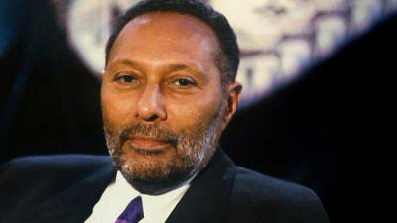
REPRESENTATION – Theoretical Approaches
Feminist Theory – van Zoonen: van Zoonen suggested that women are often portrayed as sexualised, weak or vulnerable in the media. Though the two women featured on the Mirror’s cover are from stories that seem to portray them as vulnerable, the images used connote strength and defiance in the face of adversity; also neither are sexualised.
Theory of Representation – Hall: The representation of Theresa May and other featured politicians are constructed, using media language to create meaning for the audience. The use of these “signs” by the newspaper suggest that May and her supporters belong to a specific cultural group of predominantly white, middle to ruling class British citizens. This representation transmits ideas to the reader about inequalities of power and the subordination of certain social groups in the UK. These subordinations will be either supported or criticised by a variety of external groups expressing a common ideology. Marxists and those supporting w/c rights may be critical of Brexit and the current government’s role in delivering the deal. Similarly, Post Colonialists may be critical of the concept of Brexit as a blow to the multiculturalism and therefore immigration into the UK.

Slide 14

Theoretical Approaches cont’d
Stereotype Theory – Tessa Perkins: The newspaper has tapped into the stereotype of “untrustworthy politician” in order to base Theresa May’s vote loss story around – it is this stereotype which the article juxtaposes and highlights. Labour leader Jeremy Corbyn is portrayed in a somewhat positive light. The article uses somewhat rigid and established stereotypes of staid right wing politicians to construct working vs middle class binary opposites to position the story critically in the consciousness of Daily Mirror readers.
Theory of Identity – Gauntlett: Despite the overtones of ineptitude and failure attached to Theresa May’s denied Brexit vote, she is very much seen as a potential role model to females who may wish to pursue a career in a male dominated industry. Her bravery in the face of overwhelming odds and eventual defat is highlighted throughout, and although peppered with imagery and key words dictating disappointment, the article does reflect on May’s stubbornness to continue regardless. This strong female presence is further reinforced by the cover-line promoting the story about the Eastender’s actor who was assaulted.

Slide 15

MEDIA INDUSTRIES - History
The Daily Mirror was first published in 1903 as a newspaper for women “to act as a mirror on feminine life”. However, the newspaper was quickly redesigned to appeal to a broader m/c audience. It was founded by Alfred Harmsworth, who sold it to his brother Harold Harmsworth in 1913. In 1963 a restructuring of the media interests of the Harmsworth family led to the Mirror becoming a part of International Publishing Corporation. Its sister paper, the Sunday Mirror began in 1915, starting as the Sunday Pictorial and becoming the Sunday Mirror in 1963.
It was later transformed again into a w/c newspaper after 1934, in order to reach an even larger audience.
During the mid 1960s, daily sales exceeded 5 million copies, a feat never repeated by it or any other daily British newspaper since.
The Mirror was owned by Robert Maxwell between 1984 and 1991. The paper went through a protracted period of crisis after his death before merging with the regional newspaper group Trinity in 1999 to form Trinity Mirror.
Now owned by Reach PLC, the Daily Mirror was once the most popular tabloid in the UK.
However, it has had the largest year on year fall in sales of any national print newspaper in recent years with a current average daily sales of just 509,000 copies.
The Daily Mirror Masthead has changed significantly over the period since its inception, reflecting its editorial evolution and the design features of a changing digitally focused industry; from a plain black and white title to a “red block” around the italicised name, to a much more confident striking and bold look in more recent years.

Slide 16

MEDIA INDUSTRIES – The Mirror “Online”
Online media has largely been responsible for the downturn in print sales and the Daily Mirror has responded to this by launching “Mirror Online” and having a presence on social media sites.
The Mirror Online is a free website – users can read all stories and access all features as there is no paywall to access these. There is however a large sponsorship and promotional presence throughout the home page and menu system to possibly subsidise costs.
The website offers interactive opportunities for its readers with competitions, polls and a “Got a story?” feature which invites readers to submit their own stories.
Though it doesn’t invite users’ comments on political issues, it does have accessible stories breaking down the key events into “bitesize” chunks. This further reinforces the Mirror’s brand being the “Intelligent Tabloid”.
This method of newsgathering involves the reader – further encouraging readers to become prosumers contributing via citizen journalism.
Online readers are exposed to multiple #hashtags links to breaking or trending stories and this further adds another dimension to breaking live news, giving the reader another avenue to follow the events.

Slide 17
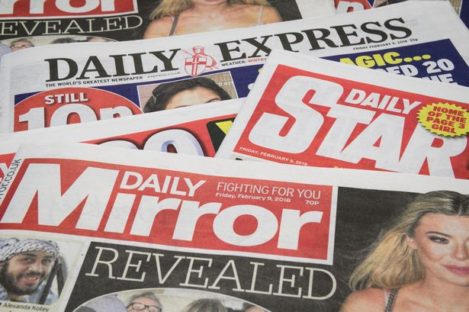
MEDIA INDUSTRIES – Ownership
Reach PLC is the largest national and regional multimedia content publisher in the UK, comprising national and regional news brands across the country.
Reach PLC publish more than 150 newspaper titles across the UK and Ireland, from the national presence of the Daily Mirror, the Daily Record, the Sunday Mirror, to local newspapers such as the Manchester Evening News, Bristol Post, Liverpool Echo and Nottingham Post.
The newspaper conglomerate regularly uses the opportunity to market across platforms, use synergy and publicise other media products which promote values and political agendas close to those of the organisation.

Slide 18

MEDIA INDUSTRIES – Newspaper Regulation
The Daily Mirror is part of Independent Press Standards. This is a regulatory body that maintains press standards but is anti-Leveson in its approach.
The Mirror has found itself chastised by this body on multiple occasions however, including: Libelling Frankie Boyle by calling him a racist, defamation of airline Ryanair’s safety procedures, a false claim of drunken behaviour of Cristiano Ronaldo in a nightclub, a libel case claiming Kate Garraway was having an affair, etc.

Slide 19
MEDIA INDUSTRIES – Theoretical Approaches
Power and Media – Curran and Seaton: Reach PLC have maintained their position in the UK market despite falling sales of the Daily Mirror and other mainstream titles by diversifying into regional news. This diverse pattern of ownership has allowed them to create the conditions for more varied and adventurous media products, as highlighted in Curran and Seaton’s theory, thus maximising their potential revenue despite the decrease of their national titles.
Regulation – Livingstone and Lunt: Reach PLC is facing increasing pressure alongside the rest of the UK press industry to adhere to strict rules and guidelines on industry practice. This has arisen after the phone hacking scandal and subsequent Leveson enquiry into the industry. There is an underlying issue of protecting citizens from harmful material while ensuring choice and press freedom. The very nature of the claims made during the Leveson enquiry highlights this.
Cultural Industries – Hesmondhalgh: Reach PLC has become a horizontally integrated company with a wide range of titles in order to maximise audiences and minimise risks. Rather than seeing digital media as a threat the company has embraced its digital expansion and now offers digital marketing as well as digital classifieds to generate additional income.

Slide 20

Target Audience
The Daily Mirror’s target audience, according to NRS and ABC data are predominantly C2DE, over 35 and are w/c Labour supporters.
Readers of the Daily Mirror have a relatively low reading age, hence the reliance of simple terms and restricted code language within stories.
Slightly more female oriented newspaper as reflected by the “female friendly” content of many stories.
A larger readership in the north of the UK, reflected in its left wing, Labour supporting, w/c politics.
A middle aged readership is typical of the media format. If the audience for the Mirror Online were to be analysed no doubt the age range would fall significantly, as younger audiences tend to rely on social media and online news as a stronger source of their daily affairs consumption.
A readership whose professions include working in the consumer goods, home and garden and entertainment industries, would match expectations of largely blue and white collar workers within the working to lower middle classes.

Slide 21
Audience Interpretation
Specifically within the Brexit Front Page and Centre Page Spread, the audience is positioned as being disapproving of May, a Tory MP, and towards the other MPs. The use of despairing, defeated language would resonate with their cynicism towards politicians, and their fears about the “chaos” of Brexit.
The red font and central positioning of the headline indicates that this story is important, but the sandwiching between adverts for gambling, along with the “Loses Again” indicates this is just another instalment in a long, tedious process, and that it is advisable to focus on more entertaining experiences.
The use of horse-racing terminology in the main article’s headlines relates to the audience’s interest in racing, and the rival political columnists describe the day’s events in the opinionated and emotive style of a sports “pundit”.
Despite much emotive and symbolic language there is actually a lot of factual detail about the Commons debate. The “cut and thrust” of the proceedings narrates what could be quite a dry and inaccessible series of arguments.

Slide 22
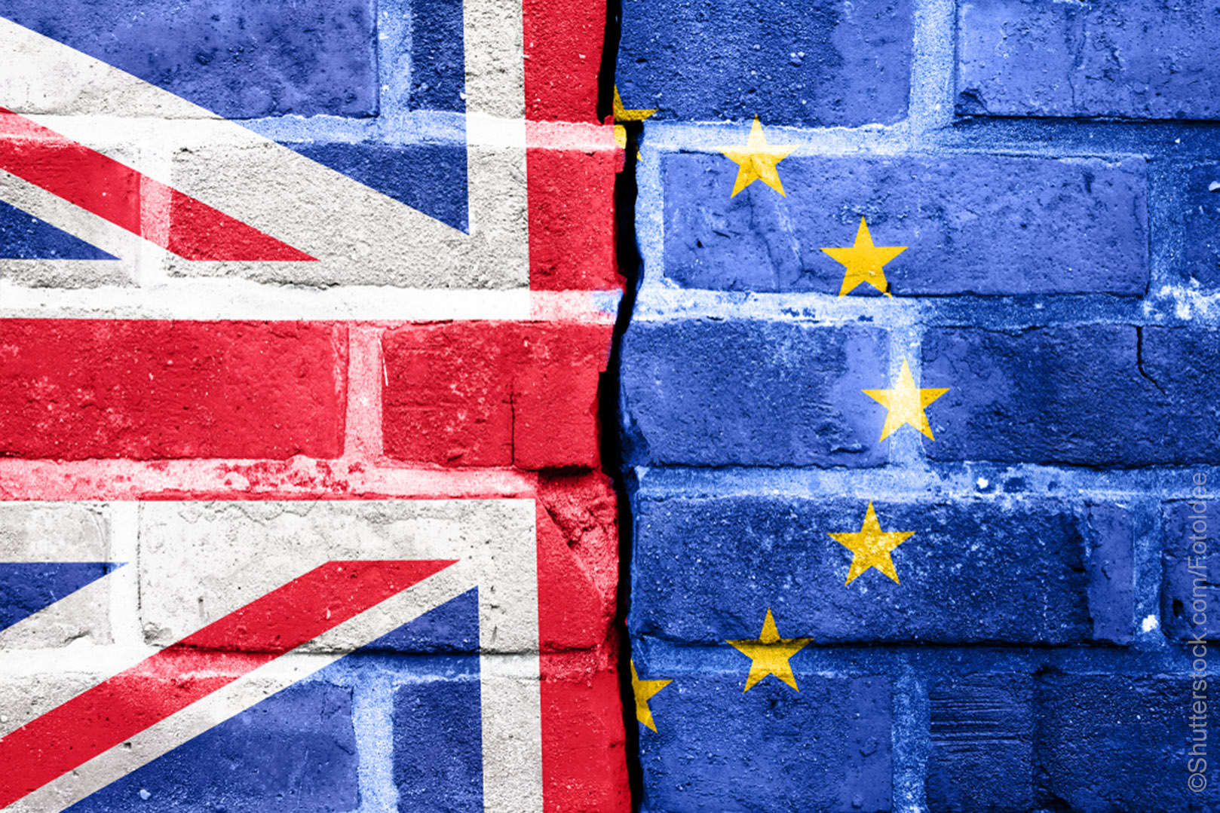
Reflecting Context
The tone of the Brexit article – and the prominence of more stereotypical working class entertainment like soap operas and horse-racing – link to ideology of “populism” that has become more prevalent in mainstream politics over the past five years. Donald Trump’s “Make America Great Again” and Nigel Farage’s attack on the “elite” encourage the view that mainstream politicians are hopelessly out of touch with the “common people”.

Slide 23
AUDIENCES – tailor made
Front Pages: Image focused. Lots of pictures to interest the potential reader. Massive headlines and only a small section of the larger story. Emphasis on puff to elaborate offers within. Stories tend to be celebrity, TV or pseudo political in nature. Stories about children also tend to receive strongest reception. Sub Headlines used to elaborate on sometimes enigma laden headlines to fil in the blanks.
Back Pages: One major sporting headline with a smaller secondary story down the side or top/bottom of page. Emphasis on large picture and massive headline to stress emphasis. Focus on football. Emphasis on national sports and teams over domestic. Small amount of copy with jump line again.
Centre Spreads: Massive picture and headline but now all story across two pages – no jump line. Tends to focus on human interest and issue of interest to left wing viewpoint but the emphasis is on the individual through interviews, quotes, etc.
Editorials: Short, located down a side bar and focused on multiple topical events via smaller headlines/sub headlines. Offers comments in keeping with the Mirror’s left wing ideologies. Favours strong values over the individual.
Letter Pages: Celebrity and Television orientated. Comments of no “real substance”, only reflect attitude and opinion which largely supports the Daily Mirror’s underlying ideologies.

Slide 24
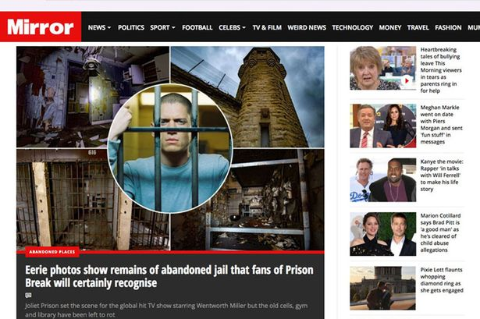
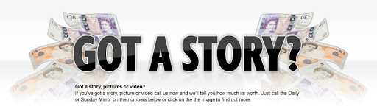
AUDIENCES – Tailor Made
Home Page: Bright, colourful and containing massive images. Home page is scrolling list of the days most important stories, smaller stories are either older or less important. Menu system in operation along header offering simple alternatives along with social media icons.
Got A Story? Page: Simple use od white space, clear branding of Daily Mirror and Sunday version. Brief description of each with clear news desk telephone numbers as contacts. Short and straight to the point to give potential contributing prosumers all the basic information they need to get involved.
Celeb Pages: Same layout as home page, large emphasis on reality TV celebrities, sex and nudity.
Sports Pages: All important stories tend to be fairly w/c sports, and pics contain various “action shots”. Also contains links to interviews with selected “sports personalities”. Further down the page there are a greater range of sports relating to a higher class and international sports.

Slide 25
AUDEINCES – Theoretical Approaches
Cultivation Theory – Gerbner: Audience exposure to repeated patterns of representation by newspapers may shape and influence their views and opinions. Gerbner went on to say that this is not like “hypodermic model” but rather depends on what the audience already believes. The messages need to resonate with an established belief in the audience. This is apparent through the Mirror’s constant reiteration of their left wing, Labour supporting values. But perhaps it could also be partly responsible with its readership’s apparent obsession with populist modern celebrity gossip.
Reception Theory – Hall: The Daily Mirror is able to promote a hegemonic – dominant reading of its viewpoint on Trump’s victory through the use of encoding and decoding, which is fully accepted by the reader. This reading is now seen as “naturalised”, as repeated exposure to the Daily Mirror’s norms and values have now legitimised and normalised this alignment to their “shared” ideologies. It is unlikely that nay regular reader of the Daily Mirror would gain a completely oppositional reading to their stories as they are probably more amenable to a right wing tabloid instead, such as the Sun.
End of Audience – Shirky: The concept of audience members as passive consumers is no longer in the age of the internet with the rise of the prosumer who can create their own content such as submitting stories and being part of forums. Newspapers like The Guardian have embraced this, taking popular “below-the-line” columns. The Mirror does offer some opportunities for “citizen journalism” but the majority of content is still written by journalists.

