Slide 1

Late Night Women’s Hour
Eloise Heasman-Ames

Slide 2

PRODUCT CONTEXT
Late Night Woman’s Hour is a spin-off from the long-running BBC Radio 4 programme Woman’s Hour.
• Late Night Woman’s Hour is broadcast once a month, at 11pm, is presented by Lauren Laverne and features a number of female panellists.
• Each episode focuses on a particular topic relevant to its female audience e.g. ‘home’ and ‘forgiveness’.
• It began broadcasting in 2015

Slide 3
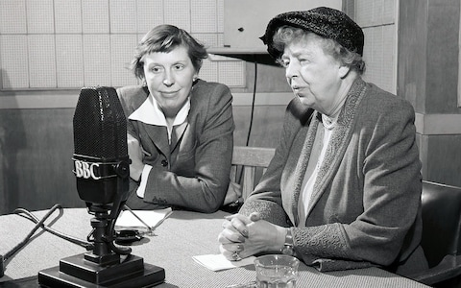
Historical Contexts
The original Woman’s Hour first broadcast in the 1940s – this could be seen as a minority audience programme – one hour a day or week set aside just for a female audience. This might further suggest that all other programming on BBC Radio was aimed at a male audience.
Further, this might suggest a strong sense of patriarchal control, both on the BBC and in UK society at the time
Late Night Women’s Hour features frank and open discussion, and demonstrates a shift in society and increased gender equality although some of the issues raised reflect the fact that society is not yet completely equal.

Slide 4


Public Service Broadcasting
Broadcasting intended for public benefit rather than to serve purely commercial interests. In other words, not to be making a financial profit.
The BBC raises its finances from the license fee – currently at £147 per year – and is paid by the UK population in order to consume TV and radio broadcasts, whether they are BBC products or not.
Since 1922 the BBC has been committed to its mission to inform, educate and entertain
Late Night Woman’s Hour could be seen as a typical example of Public Service Broadcasting (PSB) and therefore of the BBC, due to its ‘niche’ audience.

Slide 5
Niche Audiences and Media Production
Denoting or relating to products, services, or interests that appeal to a small, specialised section of the population.
It could be argued that commercial broadcasters (those who are set up to make a financial profit through advertising) might see a programme like LNWH as being too specialised, aimed at a relatively small audience and broadcast at an unpopular time.
Purely commercial institutions would be less likely to produce a product like this due to the relatively low audience figures, lack of sponsorship or advertising deals to tie-in with the programme, and its specialist nature.
The programmes have only female contributors, is made up predominantly of just dialogue (without music, sound effects etc.) and the topics explored use intellectual and specialised vocabulary.
The BBC, however, have a commitment to producing a wide selection of content, aimed at all sections of the population. In which case, LNWH could be seen as a ‘typical’ BBC product.

Slide 6
Changes in technology and how it impacts media production
Scheduling - Late Night Woman’s Hour has an 11 p.m. broadcast timeslot. However, audiences can now listen on digital devices other than radios and download podcasts to enjoy at their leisure which means the time a broadcast airs live might be less significant.
Digital technology, such as Digital Audio Broadcasting (DAB), possibly offers broadcasters like the BBC more freedom to produce challenging content which would normally got out after the 21.00 watershed (the time which more ‘adult’ themes can be shown on TV and radio, such as violence or language), and still be heard at any given time though downloadable content.

Slide 7
Theoretical approaches - Power and media industries (Curran and Seaton)
It could be argued that programmes like LNWH, and the general product output from the BBC, challenges the idea that the media is run purely for economic profit and power, while being controlled by a small number of powerful companies, such as Sky, Disney and Netflix.
Late Night Woman’s Hour might also be used to support Curran and Seaton’s idea that socially diverse patterns of ownership help create conditions for varied and adventurous productions, In other words, the more variation of media companies which exist leads to greater choice and potential risks to be taken with product.
It could be argued that the success and growth of podcasts across a range of topics and genres could also be due to the relative inexpensive production costs and hosting facilities on a range of divergent technologies.
Podcasts are also available to a wider global audience, which widens the target market.

Slide 8

Social and Cultural Contexts
The audience for Radio 4 generally can be categorised in terms of age, social class and expected levels of education. This referred to as Demographics.
Alternatively, Psychographics is the method of categorising audiences by their lifestyle, values, attitudes and tastes. Consider how Radio 4 - and Late Night Women’s Hour in particular - might benefit from a Psychographic approach.
A stereotypical Radio 4 listener is likely to be educated often to degree level, be in a managerial/senior/educational job environment, upper-middle class, aware of current affairs – and most likely male
Consideration should be given to how Late Night Woman’s Hour challenges the established audience of this channel. Some examples of these challenges to the Radio 4 audience might include the obvious gender bias (the clue is in the title), the presence of Lauren Laverne as the main presenter and the nature of the content.
Lauren Laverne should be considered in view of her background – she was once a member of an indie-rock band, Kenickie, in the 1990s. This would make her an untypical ‘Radio 4-type; presenter.

Slide 9
Audiences interpretation of the media and why audiences may interpret the same media in different ways
We might consider a male response to the content of the show and with its exclusive panel of female guests, how this might be unsettling or alienating for male listeners. The nature of the programmes are not solely female-targeted material, but quite often it does take an exclusive female ‘take’ on the subjects.
We might also recognise the ways in which the broadcast has been designed to invite audience members to enter the discussion through social media platforms – Twitter being the most popular form of response. Might the controversial nature of some of the episodes have been designed to invite strong responses and divide audience opinion?

Slide 10
Audience targeting for Late Night Woman’s Hour
Highlights the nature of PSB and the BBC’s mission of inform, educate and entertain. Designed to explicitly appeal to a specialised (educated, female) audience, with potentially a younger age group than usual for Radio 4. This might be due to the content of the programmes and the makeup of the guests.
Is its apparent success down to its uniqueness, as this is the only programme of its type on radio? ITVs Loose Women could be somewhat compared for television, but the target audience is perhaps not so ‘educated’?
The programme may also be targeting a younger audience (late teens to early thirties) with the variety of subjects featured in the series

Slide 11
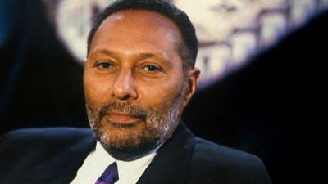
Stuart Hall’s Reception Theory
The Dominant position: A sense of an intimate medium, allowing listeners to feel engages and invested in the stories of the guests and the knowledge they have to share.
The negotiated position: They listen and are engaged with what the host talks about with her guests, but they also mold their experiences and stories to fit their own pasts and memories, therefore making it more relatable.
The oppositional positioning: Certain topics may be shared E.G. political views and the listeners may disagree with the content of the conversation therefore creating a negative view of the show in their minds.

Slide 12

Feminism and how it applies to LNWH
A broad term which could also cover aspects of society and culture.
Radio for women about women by women.
The series provides women with a vehicle through which to discuss and construct representations of gender.
The set text– ‘Home’ – sets up a diverse and challenging discussion on the subject and the changing place of women within that environment. It can also be argued that it is subverting from stereotypical feminism ideologies as it is specifically targeting women, and perhaps not the perception that men can be involved in these discussions too.

Slide 13
KEY TERMINOLOGY
AUDIENCE – target, global, positioning, categorising, profile Reception Analysis
PUBLIC SERVICE BROADCASTING
COMMERCIAL BROADCASTING
THE BBC’S MISSION – inform, educate, and entertain
NICHE MARKET
DIGITAL CONVERGENT PLATFORMS
IDEOLOGY – linked to representation and of the BBC
SOCIAL MEDIA PLATFORMS
DEMOGRAPHICS – link to Audience
PSYCHOGRAPHICS – link to Audience

