Slide 1
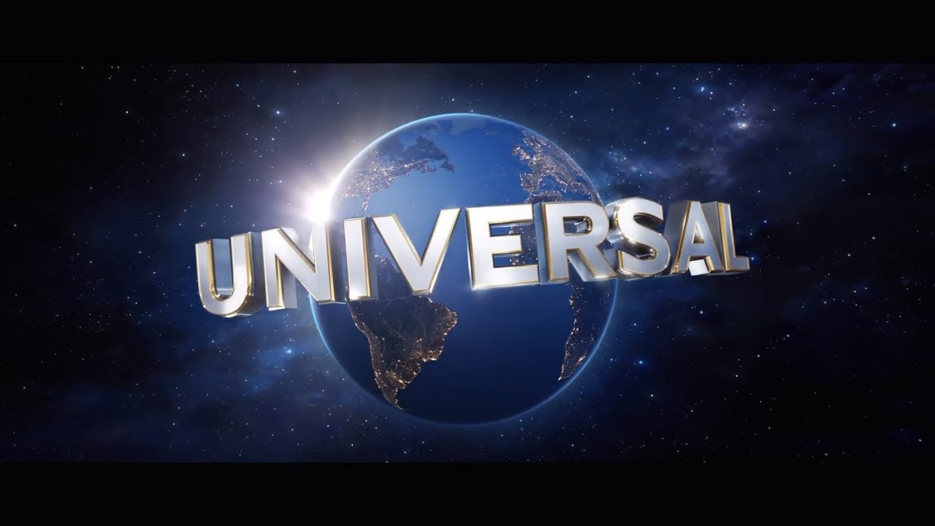
Universal Pictures

Slide 2
When was Universal Pictures created? Who created it? & Who is the current CEO?
Universal Picture was first created on the 30th April 1912, in New York
It was founded by Carl Laemmle, Mark Dintenfass, Charles O. Baumann, Adam Kessel, Pat Powers, William Swanson, David Horsley, Robert H. Cochrane and Jules Brulatour.
It makes a revenue of $4.2 billion (2011)
The current CEO of Universal Picture is Ronald Meyer (since 1995)
One of Hollywood’s ‘Big Six’ film studios

Slide 3

Who owns universal pictures?
Universal Pictures is owned by Comcast. Comcast is an American telecommunications conglomerate headquartered in Philadelphia, Pennsylvania. Through the Universal Filmed Entertainment Group division of its wholly owned subsidiary NBCUniversal. Other subsidiaries include Universal Orlando Resort, Illumination and Dream Works Animation.

Slide 4
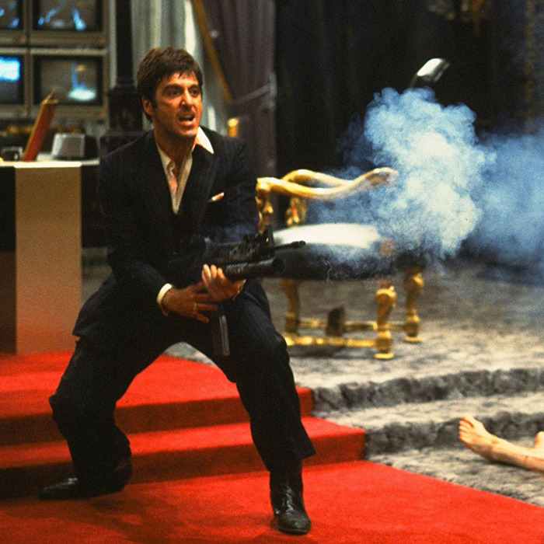
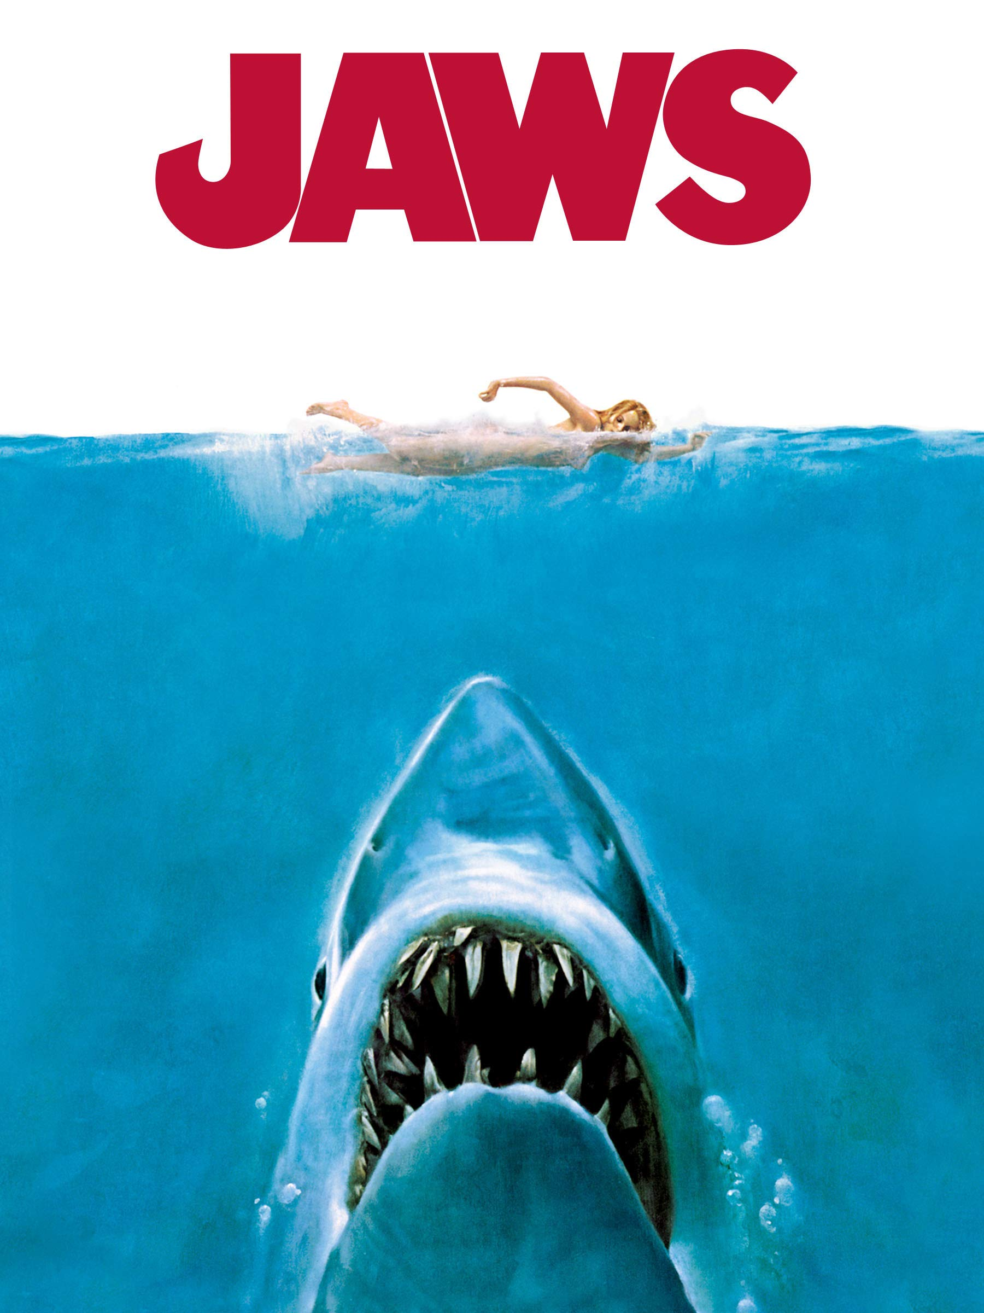
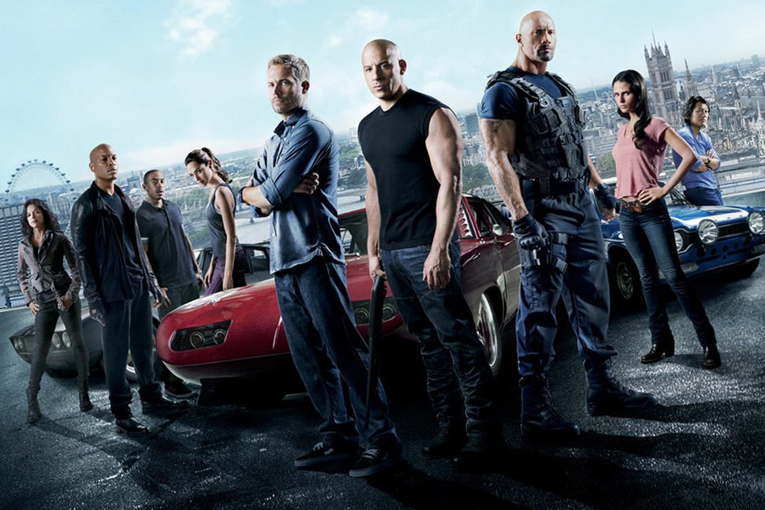
What films have been made by universal pictures?
Jurassic Park/ Jurassic World
The Secret Life Of Pets
Fast and Furious
Jaws
The Bourne Ultimatum
King Kong
Back to the future
Scarface
Apollo 13
Gladiator
The breakfast club
E.T

Slide 5
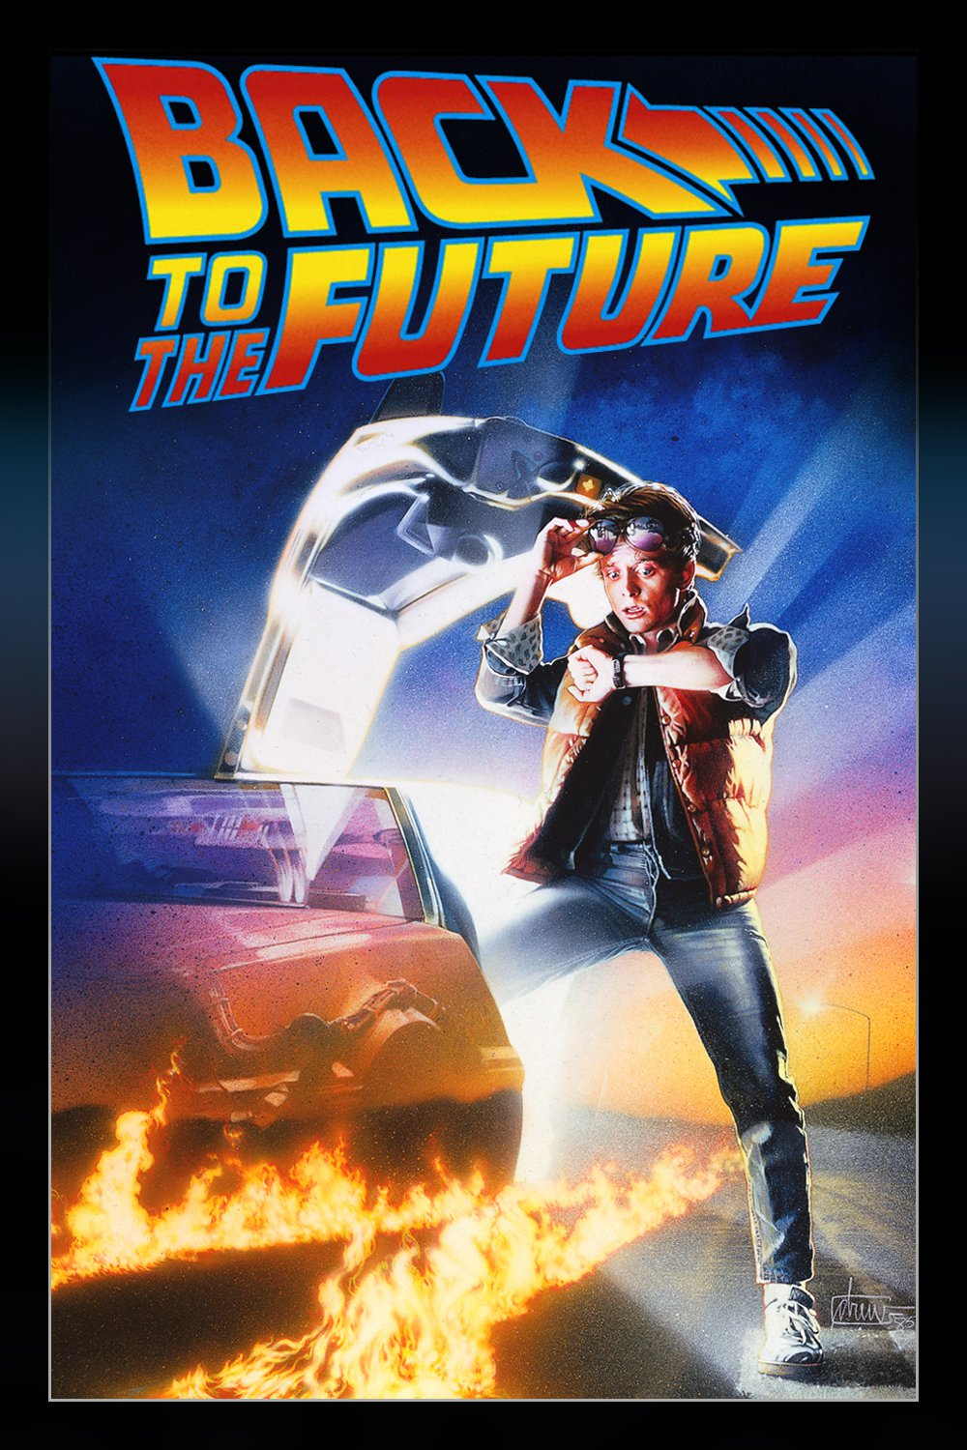
What genres does universal pictures specialise in?
Universal Pictures have a variety of genres- there are some animations (Minions, Despicable me, The Grinch, The Lorax etc).
However there are also films targeted towards older audiences (such as Scarface, Back to the future, King Kong, E.T)

Slide 6

How many Oscars has universal pictures won?
I couldn’t find much information on the amount of nominations/award wins Universal Pictures have received.
However, the studios film ‘Green Book’ received three Oscar wins (Best Picture, Best Supporting Actor & Best Original Screenplay). It also got nominations for Best Actor & Best Film Editing
NBCUniversal’s motion picture studios also scored wins for Best Adapted Screenplay (‘BlacKkKlansman’, Focus Features) and Visual Effects (‘First Man’, Universal Pictures). All told, NBCUniversal’s motion picture studios were nominated for a collective 17 Academy Awards this year (Feb 2019)
https://en.wikipedia.org/wiki/Academy_Awards#Nomination

Slide 7
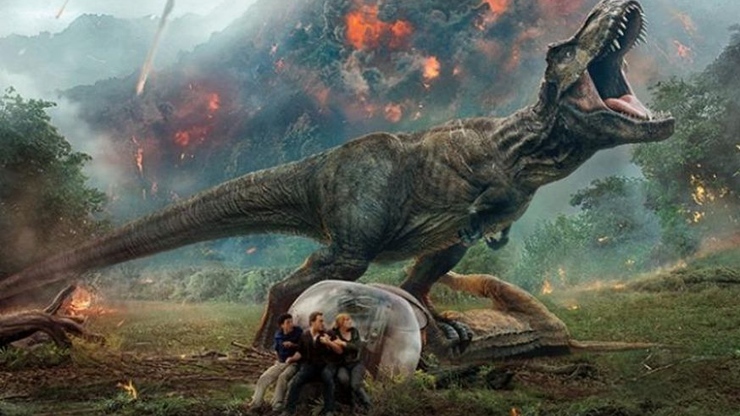
What are universal pictures’ highest grossing films/franchise? (worldwide)
Jurassic World -2015 ($1.67 billion)
Fast & Furious 7 -2015 ($1.51 billion)
Jurassic World: Fallen Kingdom -2018 ($1.30 billion)
The Fate of the Furious- 2017 ($1.23 billion)
Minions- 2015 ($1.15 billion)

Slide 8
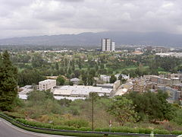
Where are universal pictures based?
Universal Pictures production studios are located in Universal City, California. Distribution and other corporate offices are in New York City. Universal Studios is a member of the Motion Picture Association of America (MPAA).

Slide 9
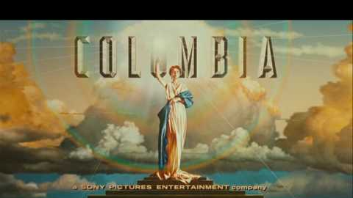
Columbia pictures

Slide 10
When was Columbia pictures created? Who created it? & Who is the current CEO?
Columbia Picture was created on the 10th January 1924 in Los Angeles, California.
It was founded by Harry Cohn, Jack Cohn & Joe Brandt.
It is a member of The Sony Pictures Motion Pictures Group, a division of Sony Entertainment’s Sony Pictures subsidiary of the Japanese conglomerate Sony.
Tony Vinciquerra is the CEO currently of Columbia Pictures

Slide 11

Who owns Columbia pictures?
Columbia Pictures is owned by an American film studio and production company that is a member of the Sony Pictures Motion Picture Group. It is currently an subsidiary of Sony Pictures, it was the second independent distributor of Walt Disney Productions

Slide 12
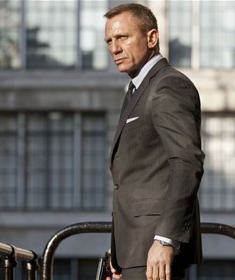
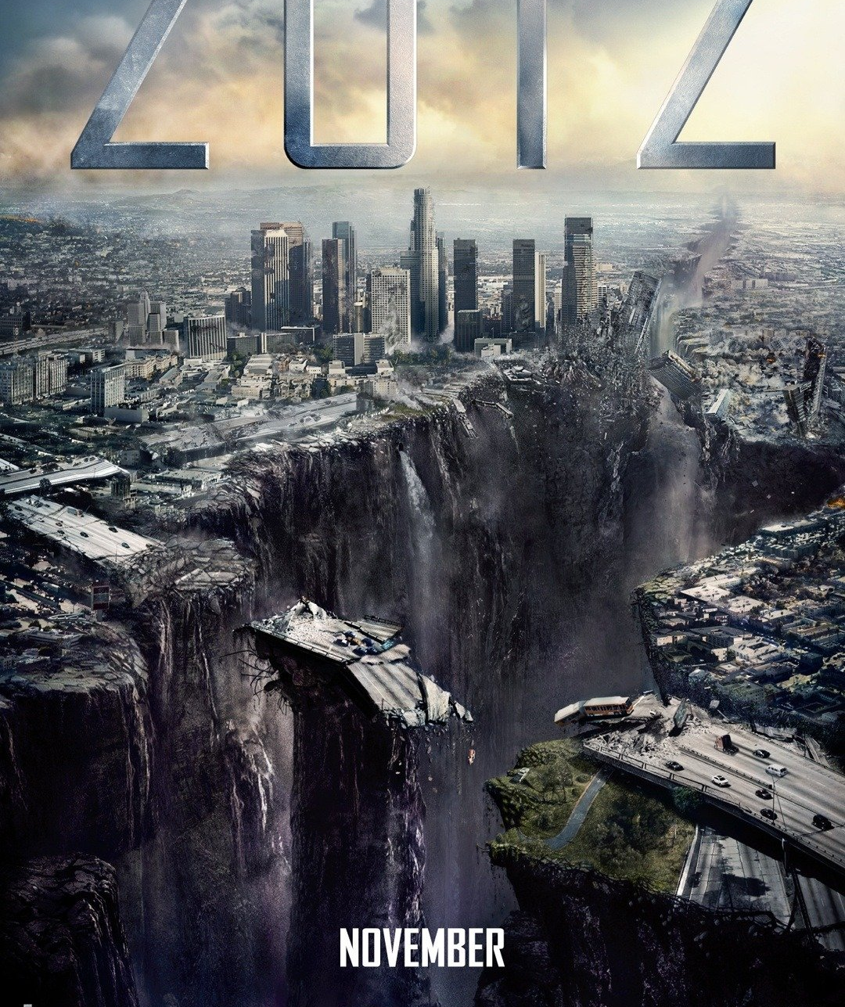
What films have been made by Columbia pictures?
28 Days
American Psycho
Skyfall
Spider-Man 3
2012
The Da Vinci Code
Shawshank Redemption
Ghostbusters
Groundhog Day

Slide 13
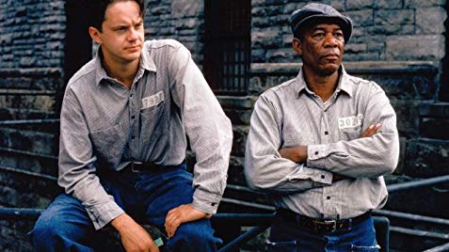
What genres does Columbia pictures specialise in?
Columbia Pictures unlike Universal Pictures have less films catered around appealing to a young audience. There are many classic films created by Columbia Pictures such as Ghostbusters (Comedy/Sci-fi) , Groundhog Day (Drama/Comedy) & The Shawshank Redemption (Crime/Drama) & The James Bond franchise (Crime/Espionage).

Slide 14

How many Oscars has Columbia pictures won?
Sony Pictures has a library of more than 4,000 films (which include 12 Academy Award for Best Picture winners). As of 2004, this unit of Sony distributes about 22 films a year.

Slide 15
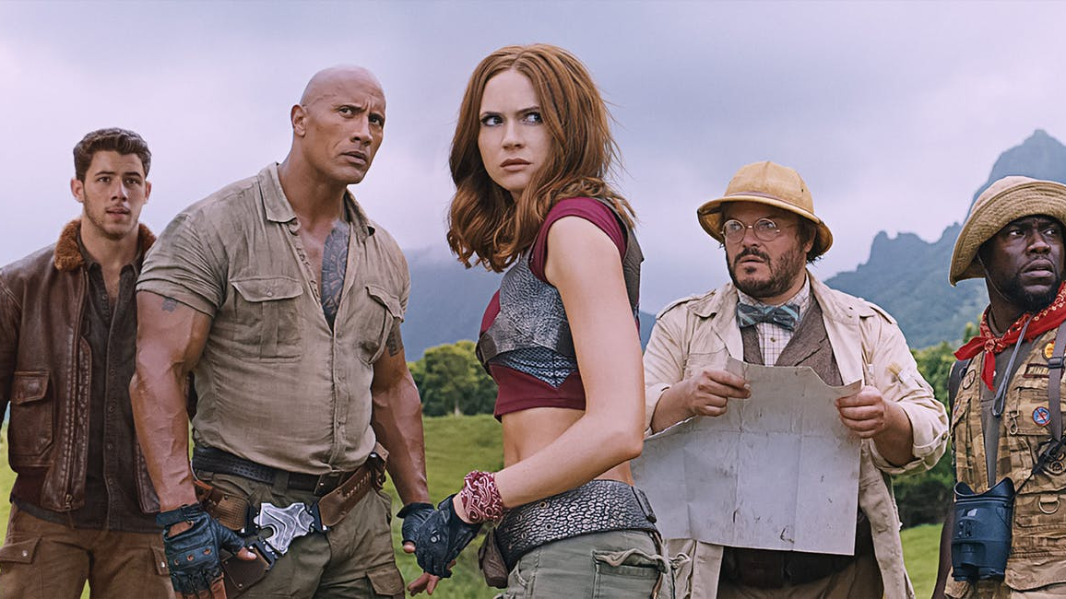
What is Columbia pictures’ highest grossing films/franchise?
Jumanji: Welcome to the jungle (2017) $960 million
Spider-man franchise- ‘Far from home’ (2019) $880 million
Skyfall (2012) $1.11 billion
Men in Black (1997) $589 million
Da Vinci Code (2006) $758 million

Slide 16
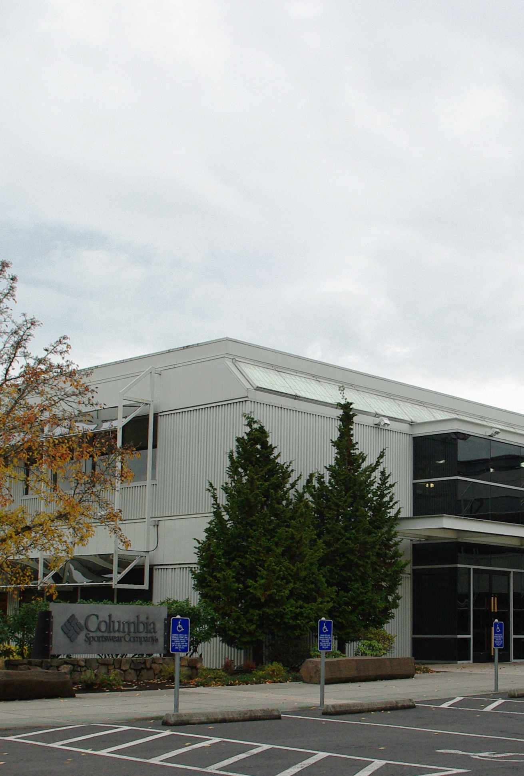
Where are Columbia pictures organisations based?
Columbia Pictures have headquarters in Culver City, California.

