Slide 1
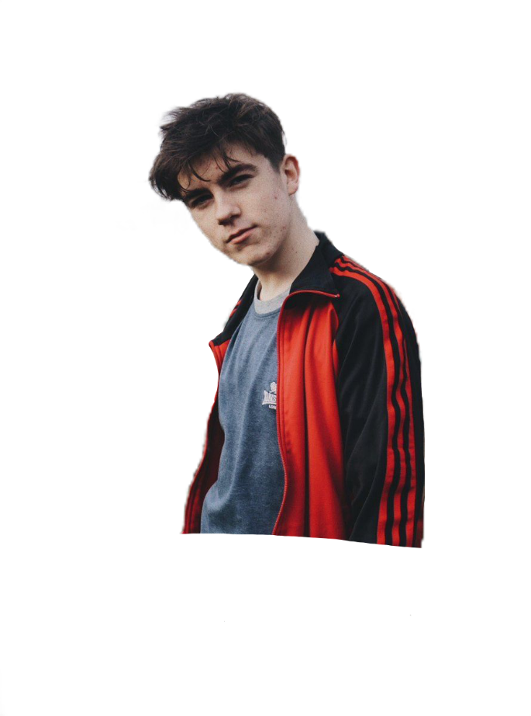
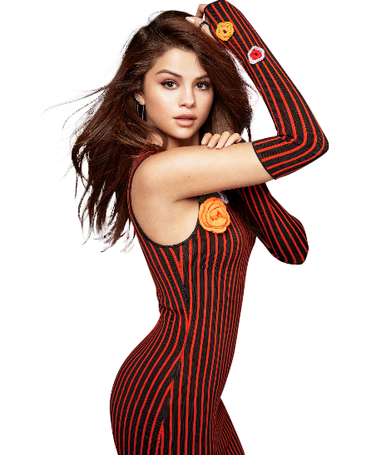
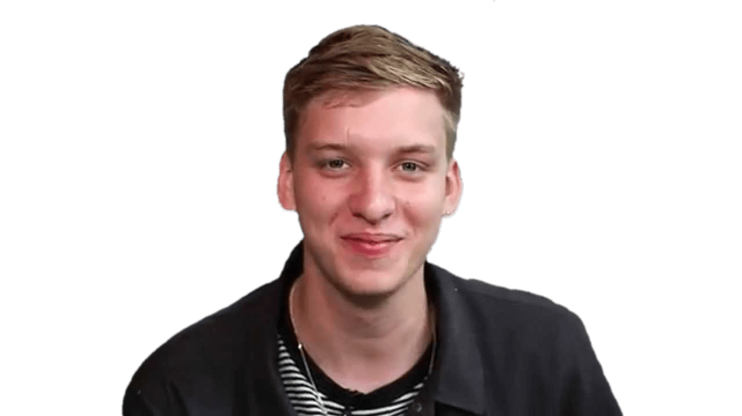
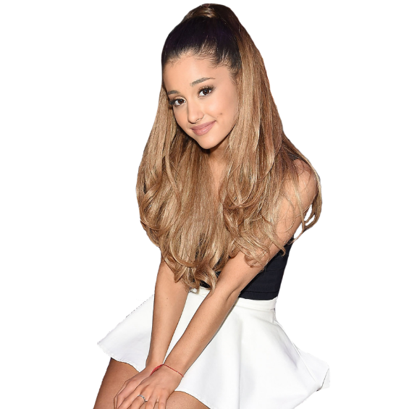
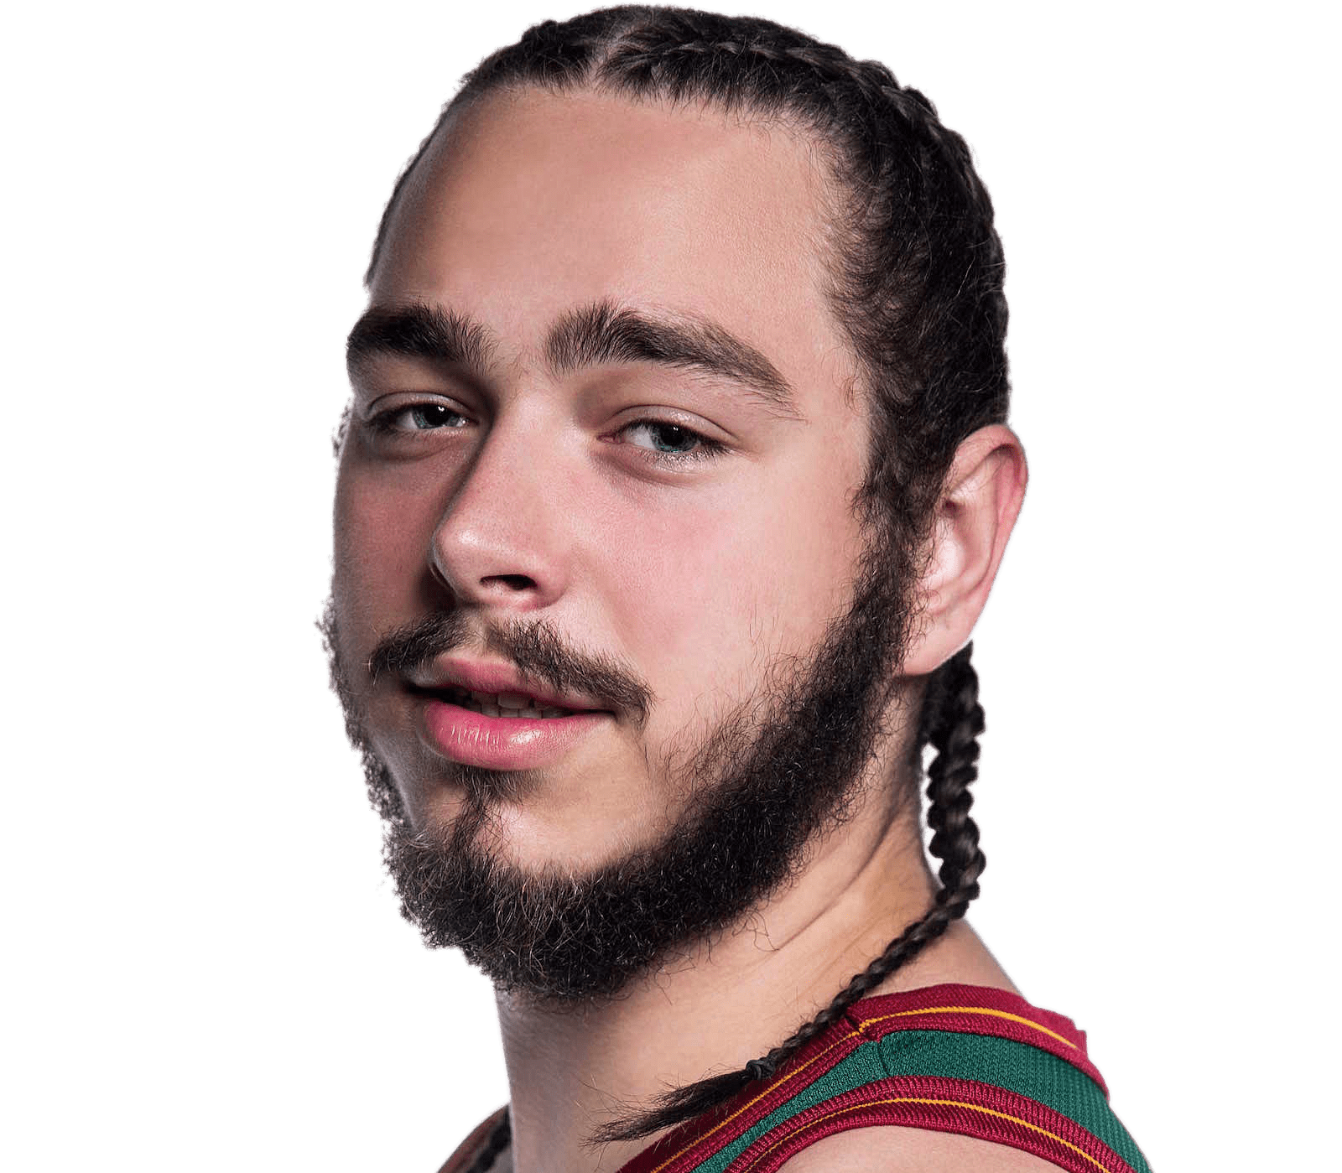
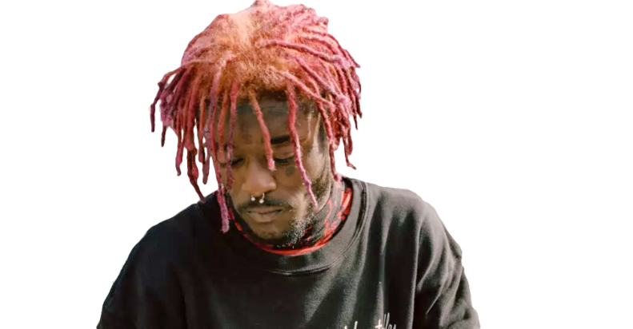
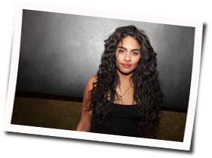
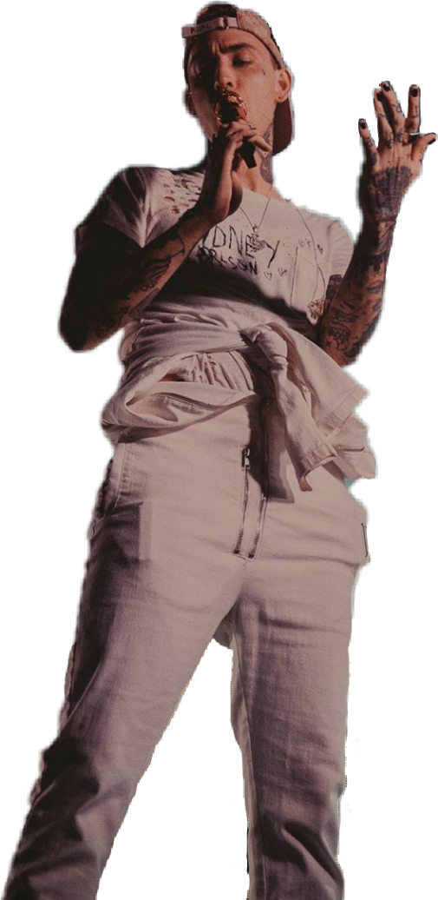
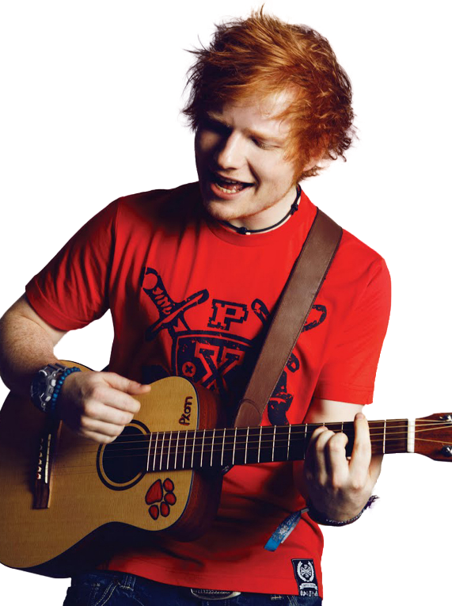
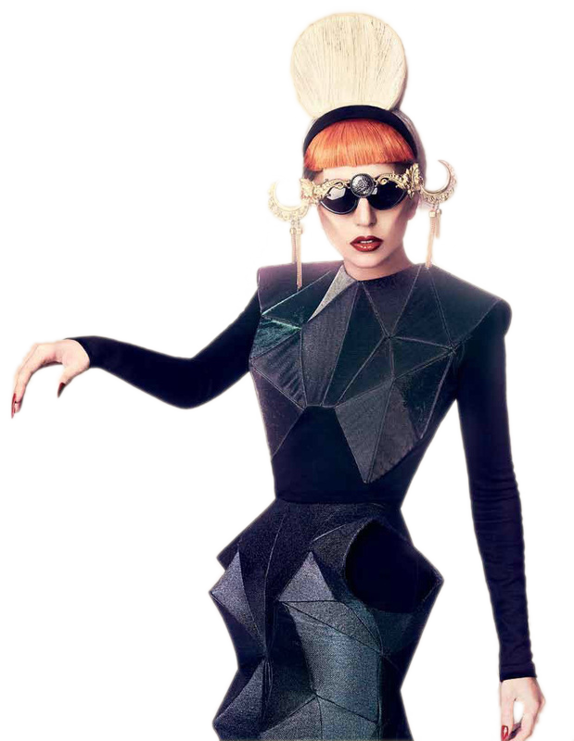
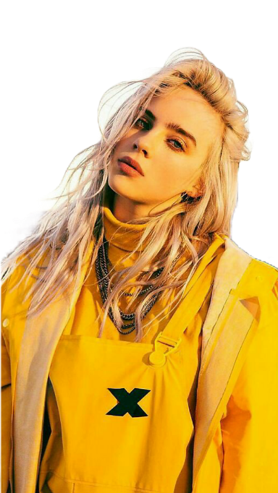
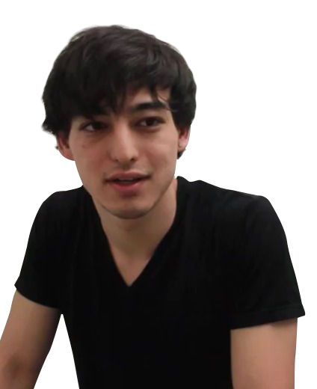
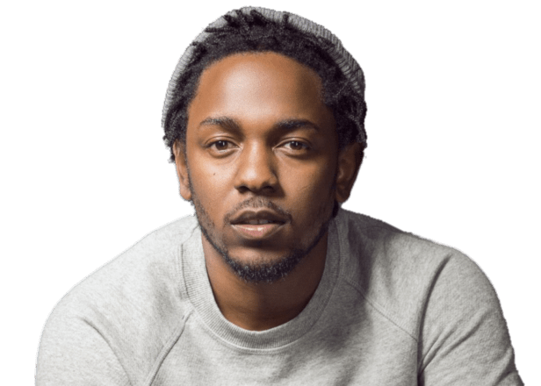
My Music Magazine
Eloise Heasman-Ames

Slide 2

Magazine Publishers
I want to create a music magazine for young people, it will include many different elements and genres to appeal to many different people. Bauer Media Group is a European media based company. The headquarters are located in Hamburg, Germany. It manages the portfolio of more than 600 magazines, over 400 digital products and 50 radio and TV stations around the world, this portfolio includes print shops. Bauer Media Group would be good publishers for a magazine because they have many different ways of promoting the magazine. As well as many successful magazines such as “Q”.

Slide 3
Who is the Target Audience?
My target audience for my magazine would be mostly teenagers, especially 15-17 year old girls who enjoy creative subjects and discovering new music. They listen to music regularly and know all the mainstream singers/songwriters, their favourite genre of music is mostly pop although they listen to a range and enjoy both mainstream and smaller musicians. They use Spotify as a streaming service and often watch YouTube as entertainment, mainly content such as Anthony Fantano (a music review channel). Their favourite thing to do is to hang out with friends in similar age groups as them and recommend songs and artists to each other. They aspire to work in creative subjects as possibly are involved in music creatively in some way, typically guitar or the ukulele. They know popular songs in the charts and listen to trending artists. However they are also the “I knew them before they were famous” type and also enjoy small indie music but can also vary with instrumentals and genres.

Slide 4

How will my magazine appeal to an audience and what kind of social media presence will it hold?
I will appeal to my target audience by having a large social media presence on mainly platforms such as Instagram and Twitter. However there will also be elements of news and updates by magazine on snapchat, as well as the occasional snapchat filter to promote a new release of the magazine’s edition. Social media will also be used to promote the magazine by the fans, there will be art contests and other competitions using the hashtag of magazine. The most common prize for these competitions would be limited edition/signed merchandise by artists or concert tickets. The twitter feed of the magazine will share news of music artists and additionally information on the newest editions that the magazine are going to be released. For premium members of the magazine with a full subscription, it will also include 3 months free of Spotify premium to appeal to music lovers further. The magazine will include a range of different genres and artists. There will be a website for members to see previews of the upcoming magazine as well as it being available for preorder, there will also be links through the website to various different social media.
Slide One

Slide 5


How will my magazine appeal to an audience and what kind of social media presence will it hold?
I will include merchandise available from the website in order to promote the magazine and in addition have exclusive merchandise in partnership with the magazine that is only available to the consumers of the product. The magazine will also have an App for members to use to look at these news sources as well as entering different competitions, the app will only be available to premium members with a magazine subscription.
Slide Two

Slide 6
What type of content will it include?
The content in the magazine will include a segment for smaller artists to promote their music for people to discover. It will also have competitions for the audience to engage with the magazine in order to win the prize. There will be special and exclusive editions at different times of the year, especially in December with two magazines being released instead of a monthly edition (The Christmas December issue and the End of Year special). The “Year in review” edition will be more expensive than the other issues as it would contain never seen / read before interviews and a quiz of the year to win prizes. The “Year in Review” will also contain a list of popular songs from that year as well as predictions for upcoming artists. Each special edition of the magazine will contain signed posters throughout and a message from the editor at the beginning, every normal edition will also have these posters but they will be unsigned.

Slide 7
How will the magazine be produced?
The magazine will have both a print and digital format. I have decided to use a print format because it will be available in superstores and create a more personal aspect because of its content. I have made a digital copy available to subscribers to generate more of a digital media platform. The print formats will include the posters so the readers have a physical copy. However, readers also have access to a digital format, the website will contain news and the app will have a digital version of the magazine. In the print format, interviews with artists will be in transcript to read but on the app there will be a video version of the interview.

Slide 8
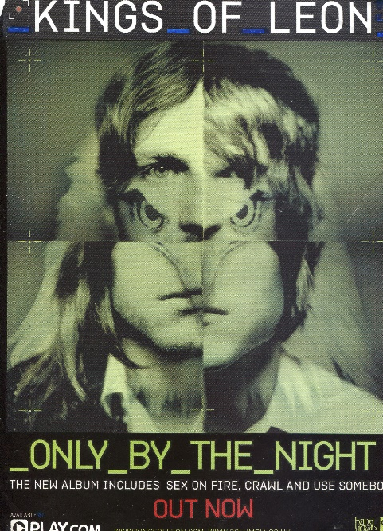
What sort of advertising will the magazine feature?
The magazine will feature a platform for smaller artists to advertise their music. It also will be used for advertisements related to music such as Spotify and other music streaming services to promote their apps and products. Media equipment which may link to the audience such as cameras as they may be into photography or other creative subjects could possibly be promoted and advertised in this magazine. Companies who sell instruments such as guitars could also be involved. In the print magazine, it will include phone numbers and websites whereas on the digital platform it will also include social media links to contact and follow different music related companies. On some pages there will be larger forms of advertising with artists selling their albums, this could possibly be incorporated into a poster for fans such as the one shown.

Slide 9
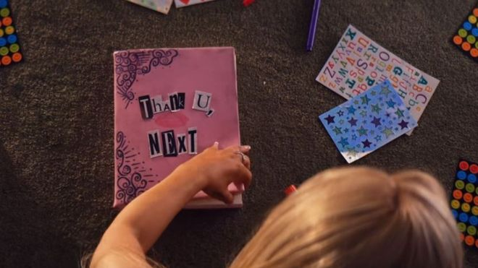
What will make my magazine unique?
My magazine will be unique to its genre because it will appeal to both music and media lovers. It will contain a section of the magazine dedicated to analysing music videos (such as Ariana Grande’s “Thank u,next”) for fans of the artist to further understand its contexts and intertextual references. The app will engage with its audiences with chances to talk to artists as well as quizzes to find out the type of genre the audience likes (so the magazine can focus on this in the next issue), this then produces song recommendations to the reader based on their music taste. There will also be more obscure interviews with artists where they give their fans tours of their houses and behind the scenes of music videos. The magazine will incorporate teasers and previews of upcoming music videos for the reader. There will also be a specialised forum for various artists managed by the magazine which produces news and theories on albums which the fans of the music can include and involve themselves in.

