Slide 1
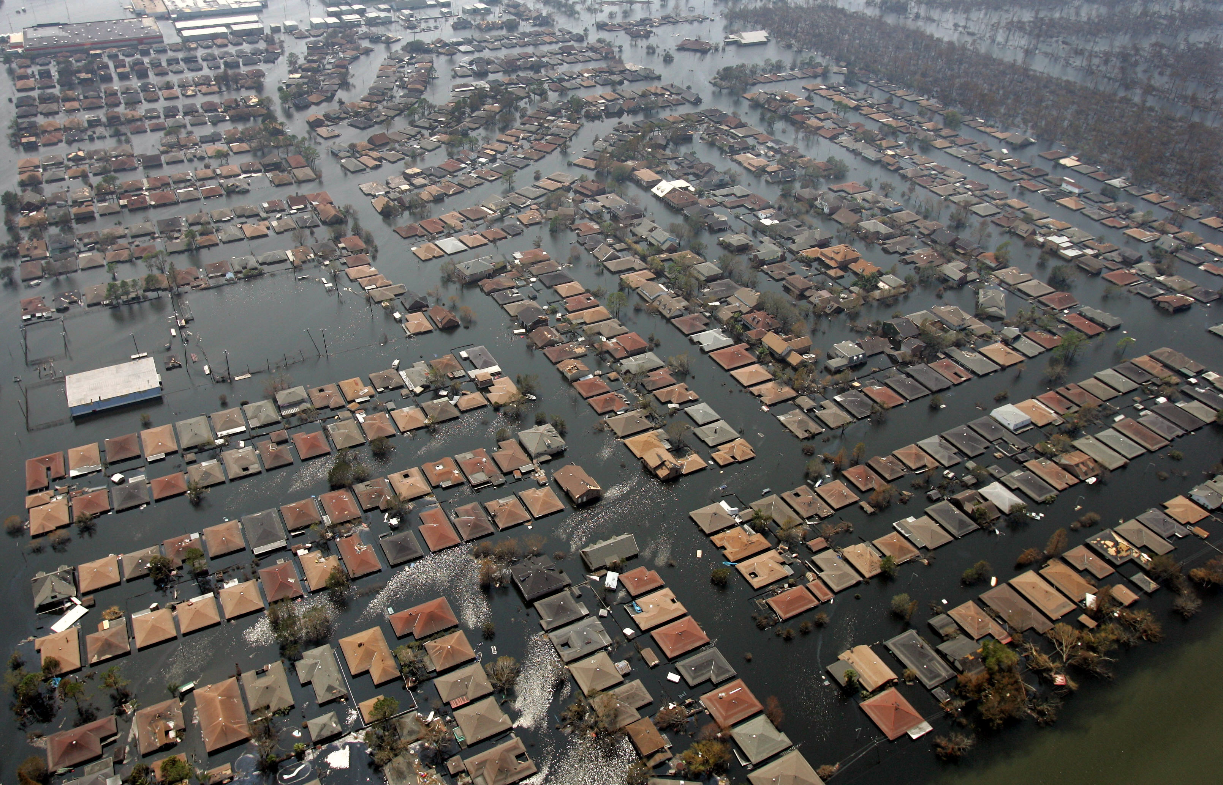
Hurricane Katrina and the Devastations of New Orleans
By Daisy, Holly, Holly and Lilly

Slide 2
Hurricane Katrina
Where ? – From Central Florida to Eastern Texas.
When ? 23rd August and 31st August 2005
Why ? – Katrina was caused because of a tropical depression with conditions of low pressure. It was a massive hurricane formed in the Atlantic and the storm was described as being among the worst natural disasters of all time.
What ? – Hurricane Katrina was the largest and third strongest hurricane ever recorded t make landfall in the US 9 went from Florida to Texas but the most damaged was New Orleans) it affected 20 states in the USA, It caused $81 Billion in property damage.
Who ? – 2000 people were effected, 1,836 fatalities.

Slide 3
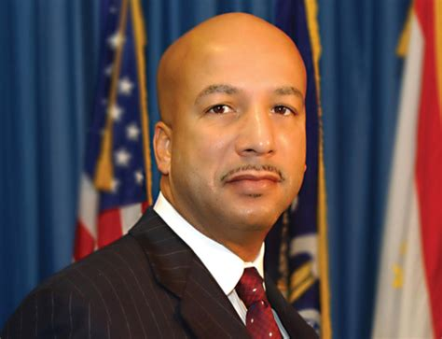
Reaction to the hurricane
Citizens stated that there was mismanagement and lack of preparation made by the government in the relief effort response to hurricane Katrina and its aftermath. For example: the delayed response to the flooding of New Orleans, Louisiana.
Criticisms from politicians, activists, pundits and journalists of the federal government.
New Orleans Mayor, Ray Nagin was also criticized for failing to implement his food plan and ordering residents to shelter with no food, water, security or sanitary conditions.
The emergency evacuation was delayed until less than a day before landfall, which lead to hundreds of deaths.
Ray Nagin (New Orleans Mayor)#

Slide 4
Criticism of the Evacuation Process
New Orleans is one of the most densely populated and poorest areas in the United States.
There was no provisions to evacuate homeless, low income, or sick individuals, nor the city’s elderly residents.
New Orleans residents who waited out Hurricane Katrina, more than 1 million residents were forced from their homes many left with almost nothing.
Those who occupied the poorest and most heavily African American wards in the New Orleans arrived with the fewest resources.
Many Families have split up.

Slide 5
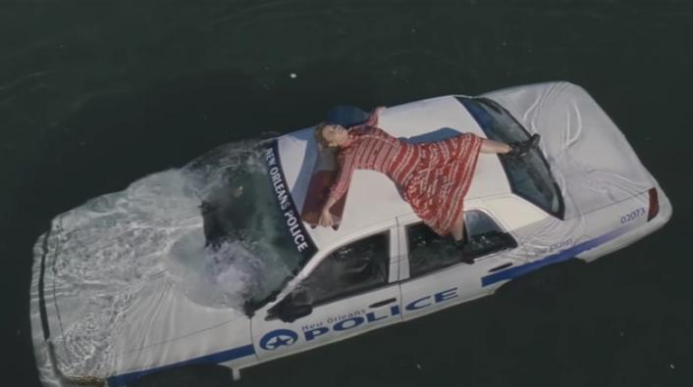
Beyoncé's Reference
In her video for 'Formation', Beyoncé referenced Hurricane Katrina by lying on top of a sinking car, in the middle of a flooded road. Her video also showed other cars sinking into the body of water. This also referenced the devastation from the hurricane, including the influx of now homeless people and lack of food and supplies.
Sinking houses and wrecked buildings can be seen in the video, as well as police cars and ambulances, to show the devastation caused from the hurricane. Clips from a Sundance Documentary shows New Orleans disaster footage after Hurricane Katrina as well as a look at bounce music and the emergence of black gay rap in NOLA.
https://www.youtube.com/watch?v=WDZJPJV__bQ

Slide 6
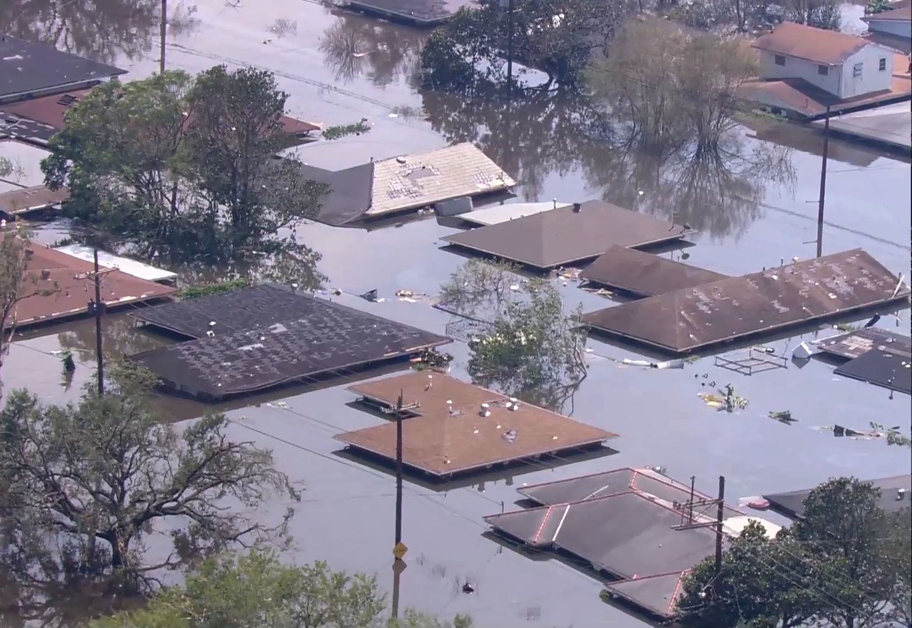
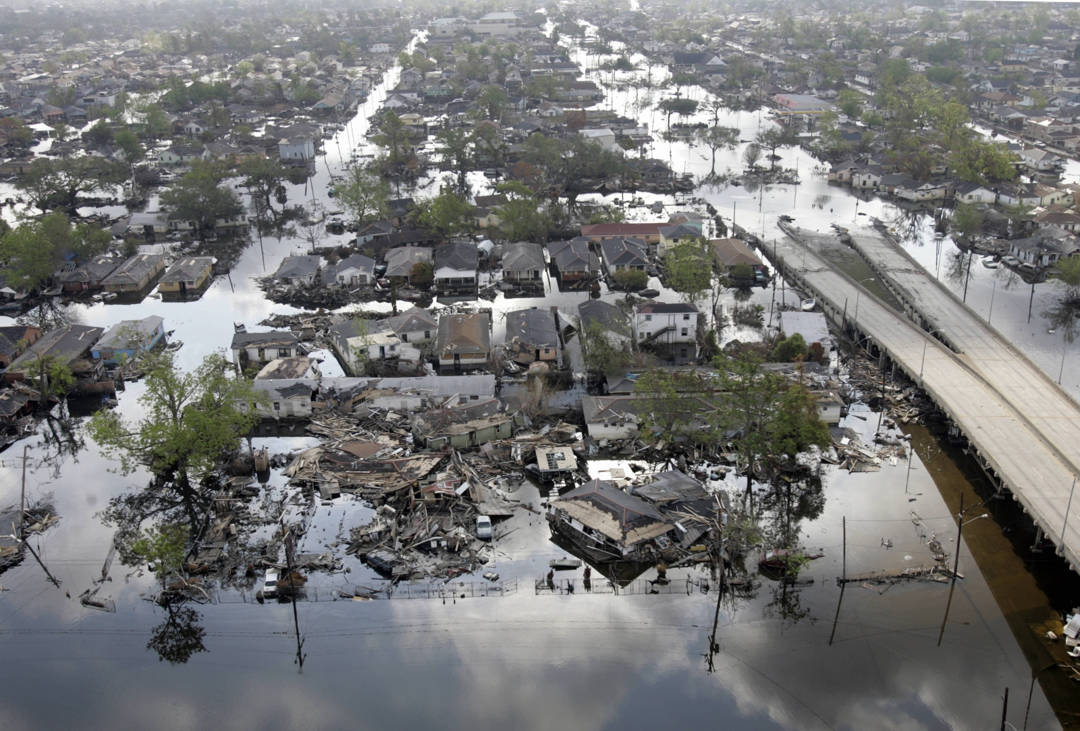
Effects of Hurricane Katrina in New Orleans
The total economic impact in Louisiana and making it the costliest hurricane ever in USA history.
Those in New Orleans, had their homes and businesses destroyed.
The poor were effected by a number of risk factors that were failed to succeed

Slide 7
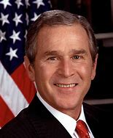
Celebrity responses to the Hurricane Katrina;
John Travolta and wife Kelly Preston flew his private plane to deliver a load of supplies and tetanus vaccine to Baton Rouge and New Orleans.
Curt Schilling opened his home to a family of nine driven out of their New Orleans home.
Sean Penn actually went to Louisiana, to help people.
Kanye west gave a massive donation to those suffering in New Orleans especially the black, and he says how he hates the way they are portrayed in the media.
Kanye west vented the frustration felt by many regarding the governments response to the 2005 hurricane in new Orleans, West stated “George bush doesn’t care about black people”.
https://www.youtube.com/watch?v=pXyryUHItuc
George Bush ( President at the time )

Slide 8
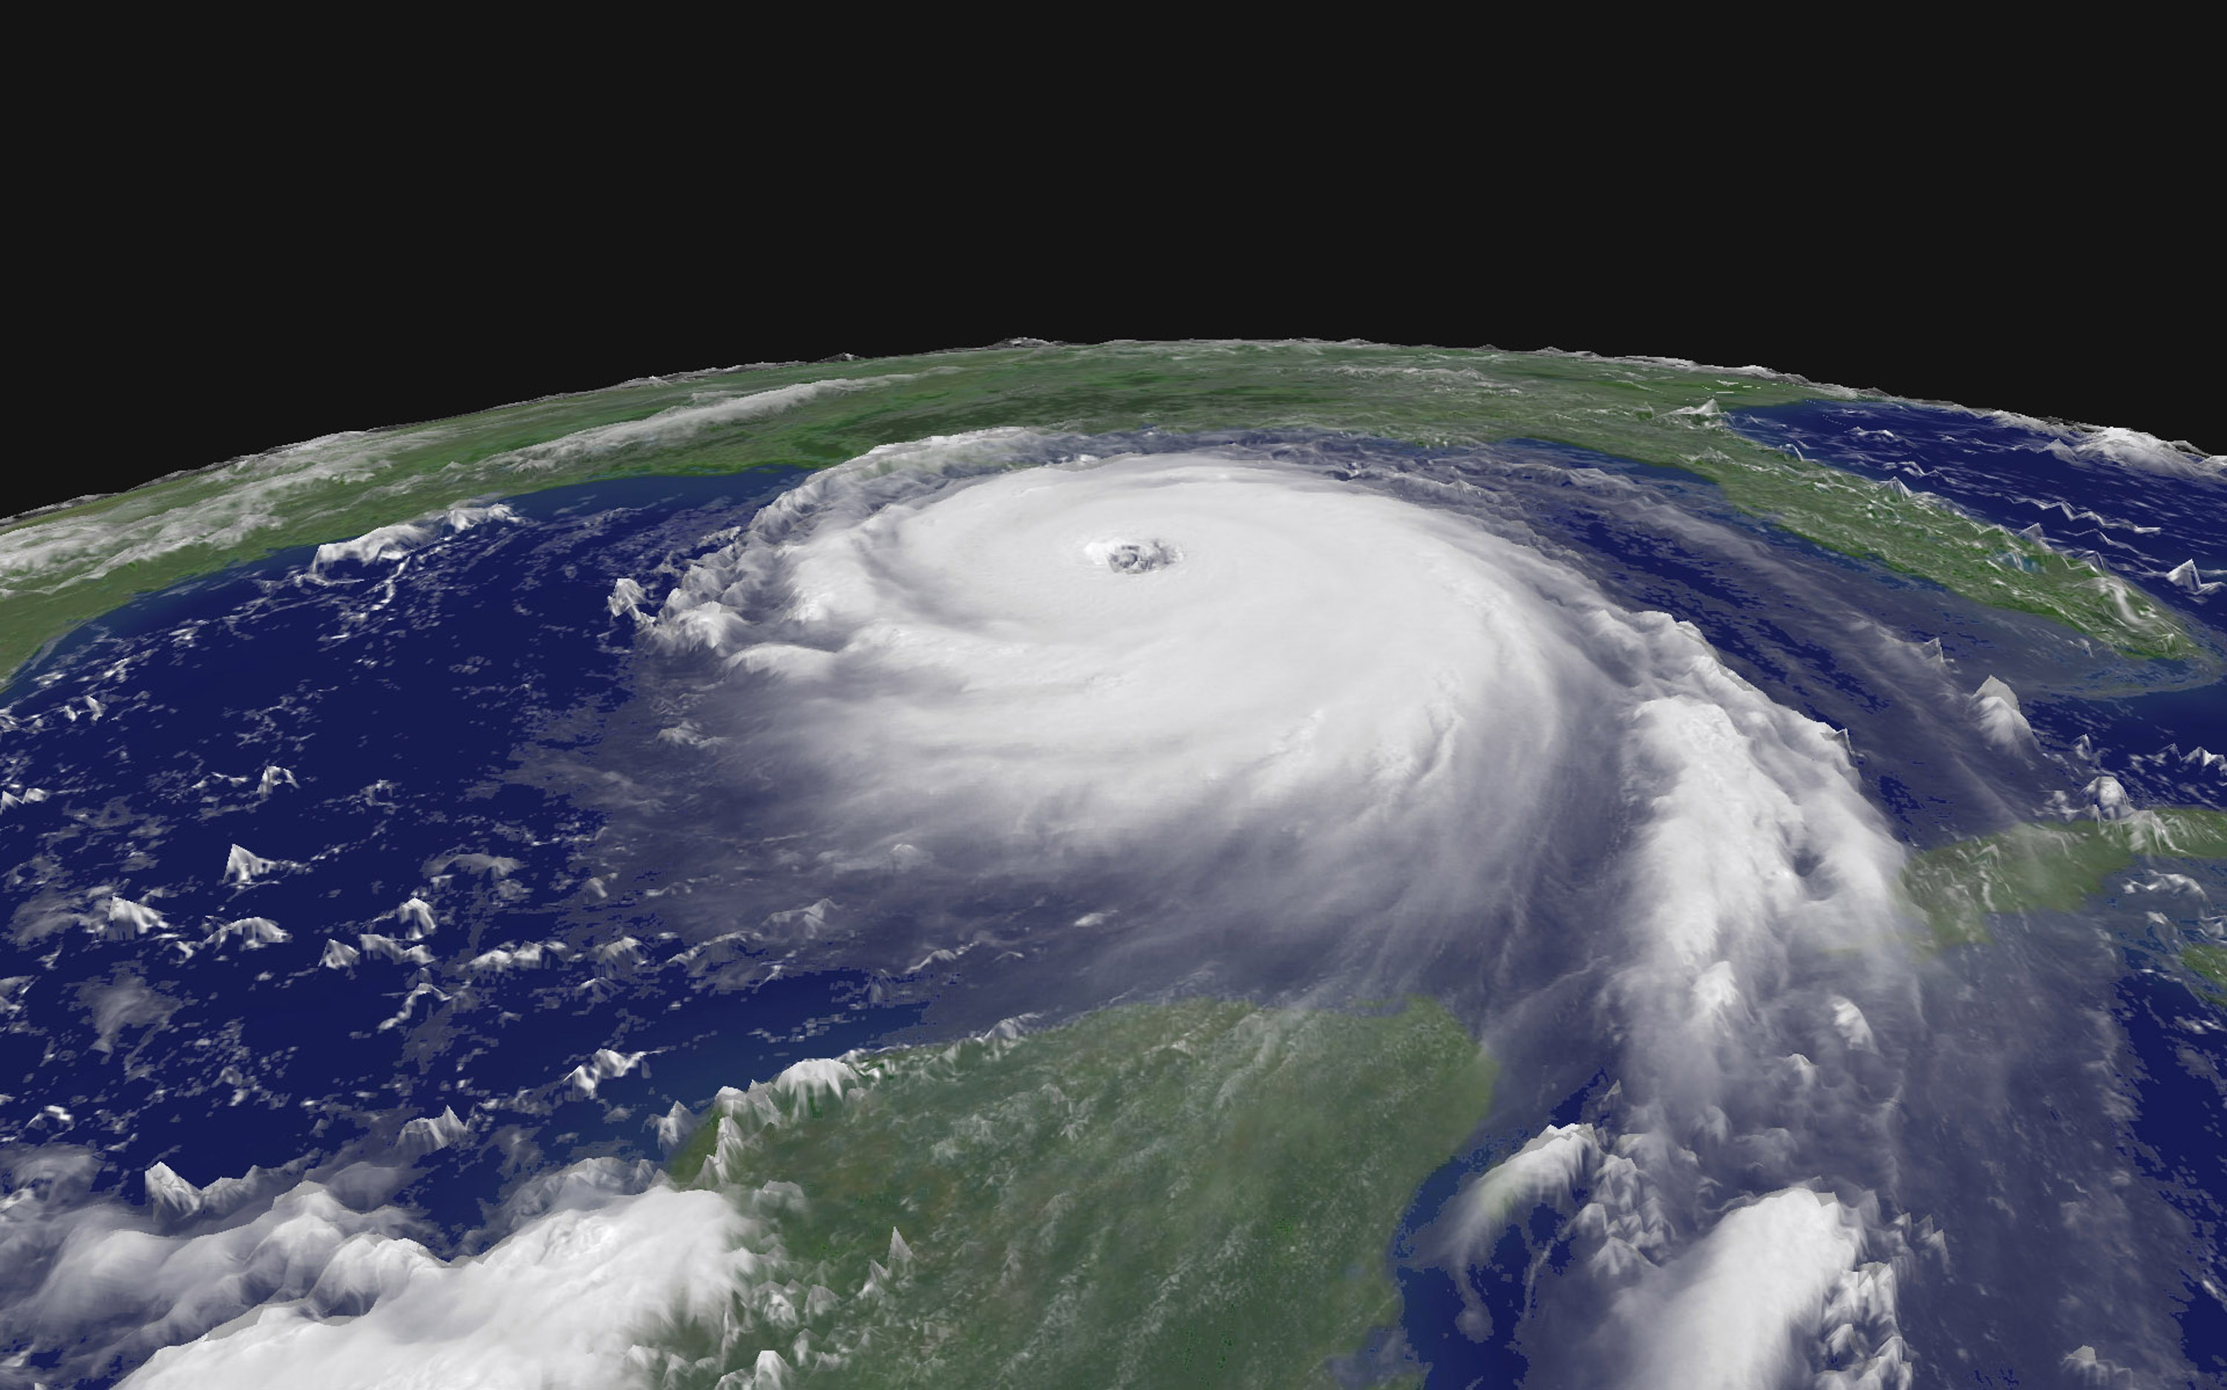
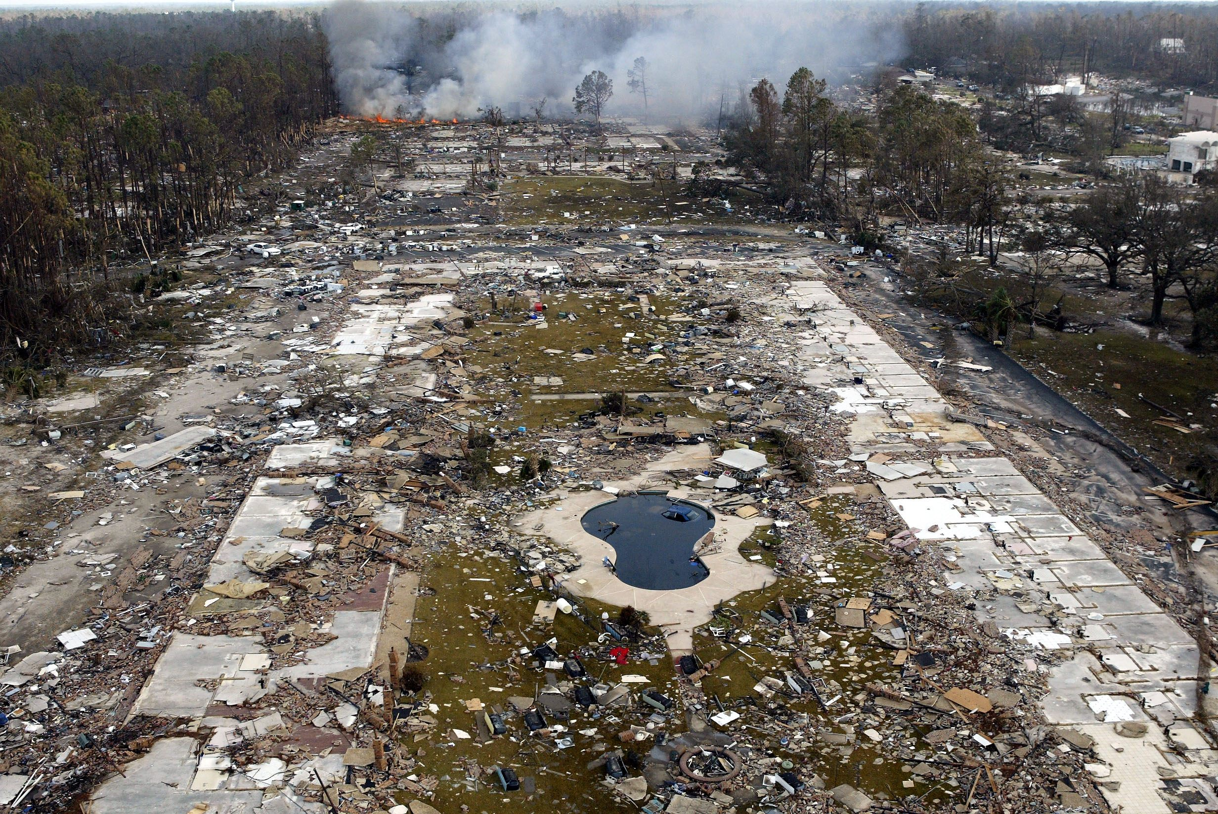
Images of the hurricane :

