Slide 1
Black feminism

Slide 2
What is black feminism?
Black feminism is an idea that class oppression, sexism, racism and gender identity are connected.

Slide 3
History
1851 – sojourner truth gave a speech at a women’s rights convection challenging both racism and sexism faced by black women.
1892 – Anna Julia Cooper realised a book called ‘a voice from the south’ which highlighted the importance of black people speaking out about the issues they faced.
1970’s – group formed called Combahee river collective who saw intersectionality (the way gender, race and other social categories affect an individuals life outcomes) as an essential factor that separated white from black feminism
20th century – black women remained active in social justice movements.

Slide 4
Criticism
Critics argue that a separation between the two races weaken the overall goal.
Can be argued that sexism and racism are two separate issues.
Can be argued that it is disrespectful to compare the problems facing slaves and those during the civil rights movement to the comparatively small issues today.
Can be argued that just because women are involved in black lives matter doesn’t make it a feminist movement.
Some say a movement raising an issue without offering a solution is a useless movement

Slide 5
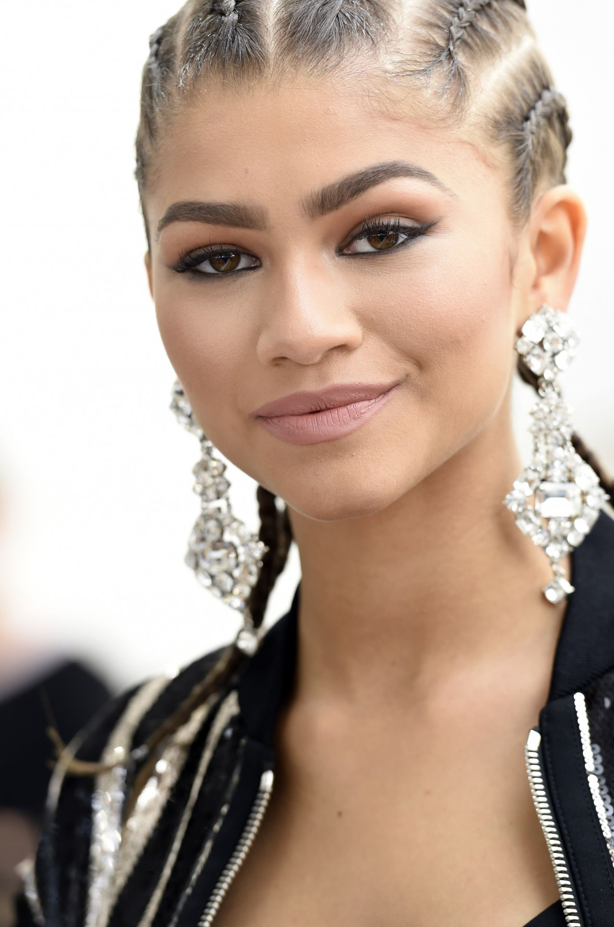
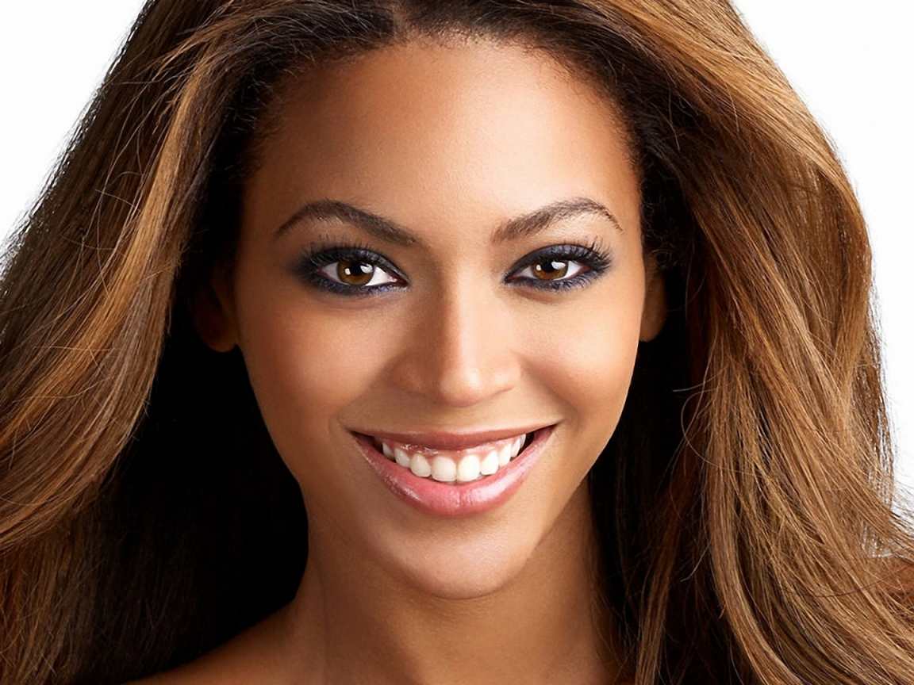
Examples in media
Beyoncé – anonymous bailing of black lives matter supporters out of jail etc.
zendaya – addressed discrimination after critics.
Due to lack of representation in mainstream media there are not many celebrities backing this movement.

Slide 6
How does this relate to black feminism?
Majority of dancers are black women, dressed relatively stereotypical but not being objectified, showing that female bodies can be celebrated without being sexually exploited.
The majority of men are seen to be in relation to Beyoncé, either working for her or involved with her in some way, this is almost reversing stereotypical roles we see in the media, showing that black women can be strong and powerful.
The title ‘Formation’ can create several different connotations, but along with the unified dancing of the women it goes to show how black women can united and be strong together in ‘formation’.

Slide 7
How does this relate to black feminism?
The video also celebrates the beauty of black women, with nods to Blue Ivy’s afro, praising these features rather than demeaning them.
Beyoncé is sat on top of a car that is sinking, this could represent political women who have been flooded and flushed out by society.

