Slide 1
Crime

Slide 2
History of the Crime films
The history of crime is complicated due to its continuous change and development over the years.
Crime films came from radical ambivalence towards the romance of crime, this particular romance have detectives like Sherlock Holmes in the early 1900’s (although it is unclear of the exact date)
Post-war crime films began to appear to due to the collective anxiety around the nuclear bomb (Kiss me deadly, 1955) as well as psychological thrillers by Alfred Hitchcock
In the 60’s spiraled the introduction of spy films, particularly James Bond who is still to this day one of the most popular and iconic movie franchises
In the 70’s-90’s, they were often to bleak the view of American politics (JFK, 1991) and in the late 1900s became a heightened public fear of crime and a fascination for the public justice system, especially towards lawyers.

Slide 3
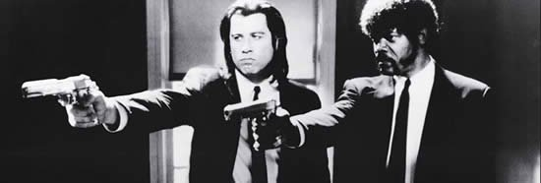
Sub-Genres of the Crime film
Film Noir-Often crime/mystery genres where private detectives solve a crime
Gangster Crime
Heist Films
Genre Hybrids also include:
Drama/Crime
Crime/Comedy

Slide 4

Iconography of the Crime film
Types of characters- (Gangsters, mob bosses, drug dealers) and the police, MI6, CIA etc
Typical setting- Office, Mansion, Streets, Crowded cities
Typical narratives-Mysteries, life of crime, taking the viewpoint of the criminal
Props- Guns, cars, money
What you typically see in these films are police chases and death/murder

Slide 5





Actors/Directors associated with Crime films
Stephen McHattie
Denzel Washington
Vincent D’Onofrio
Idris Elba
Jack Conley

Slide 6
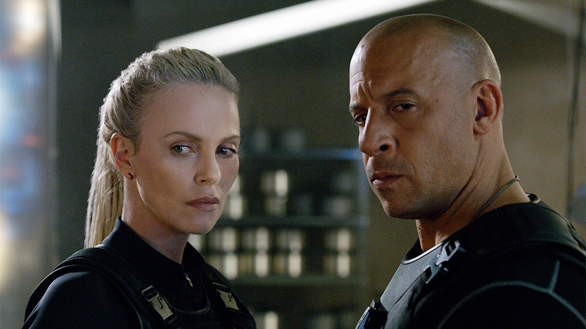
Box Office – Top 10 films of the Genre
F&F7(2015)- 1.516 billion USD
The fate of the furious(2017)- 1.239 billion USD
Zootopia(2016)- 1.024 billion USD
The Dark Knight(2008)-1.005 billion USD
Fast & Furious 6(2013)- 788.7 million USD
Fast Five(2011)- 626.1 million USD
Sherlock Holmes(2009)- 524 million USD
Rush Hour 2(2001)- 347.3 million USD
Beverly Hills cop(1984)- 316.4 million USD
Austin Powers in Goldmember(2002)- 296.7 million USD

Slide 7
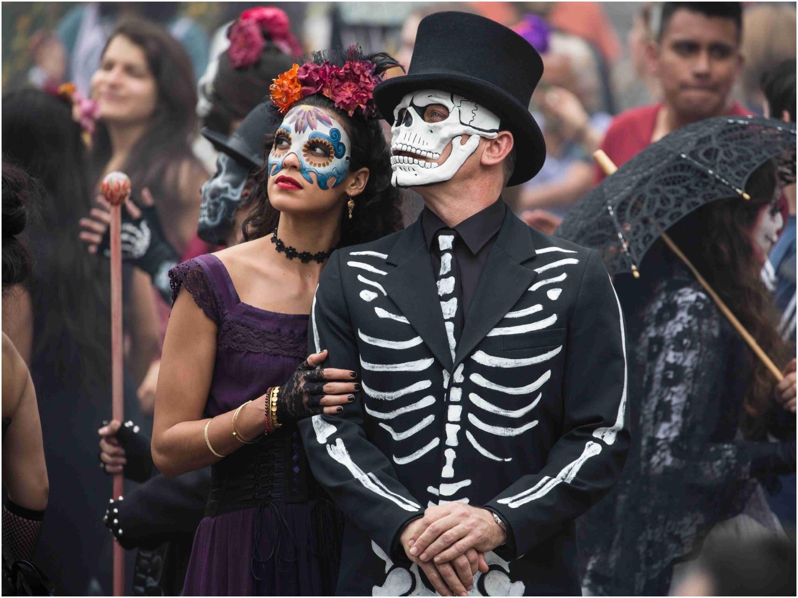

Budgets – Top films of the Genre
Spectre (2015) is the highest known crime film budget- $300 million and making $880.7 million in box-office

Slide 8
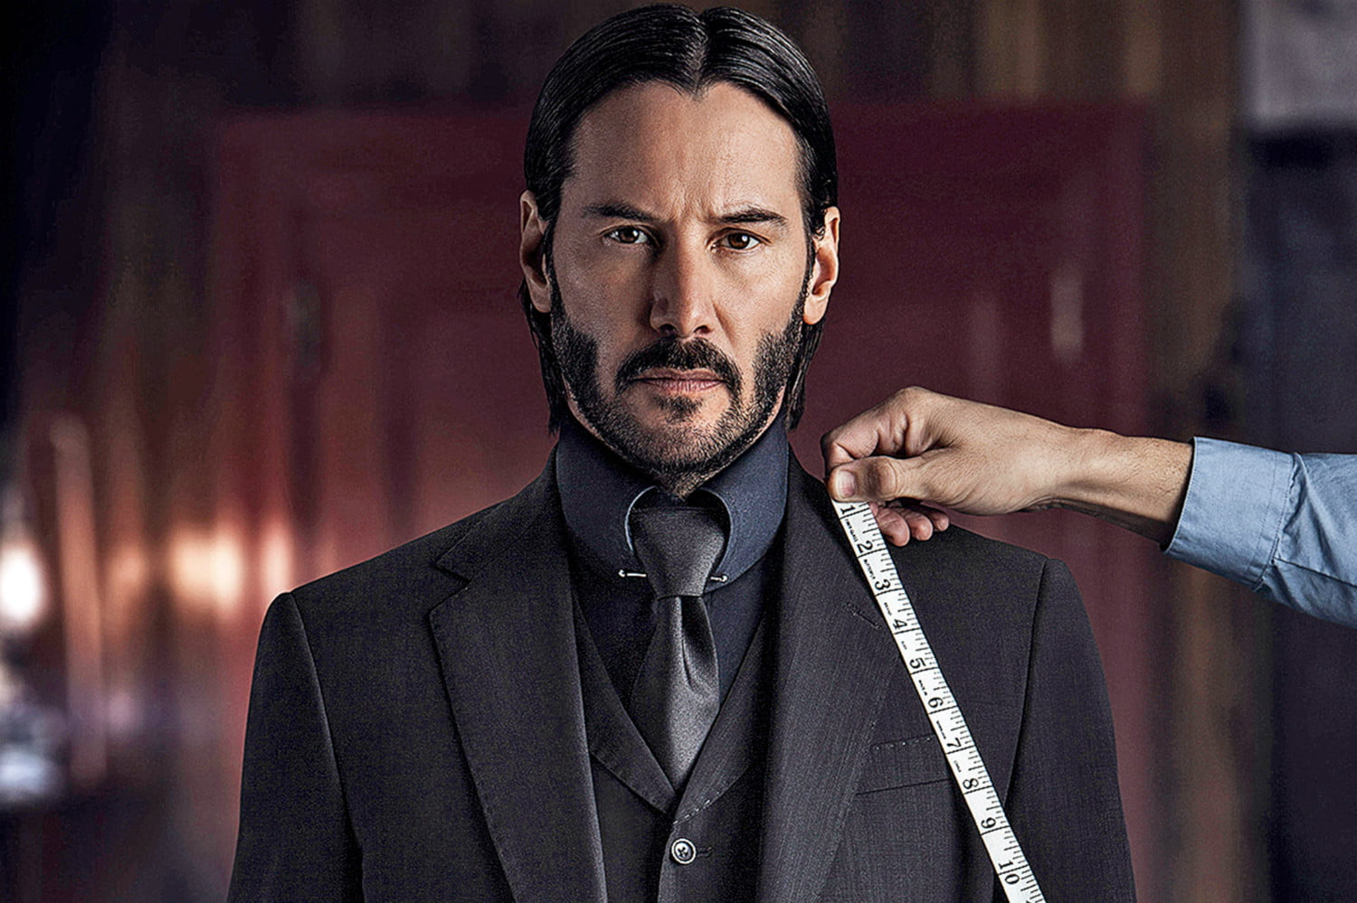
Critically acclaimed examples
The Shawshank Redemption(1994) 9.3/10
The Godfather(1972) 9.2/10
The Dark Knight(2008) 9.0/10
John Wick(2014) 7.3/10
Goodfellas(1990) 8.7/10
City of god(2002) 8.6/10
Se7en(1995) 8.6/10
The Usual Suspects(1995) 8.6/10
Snatch(2000) 8.3/10

Slide 9
Stretch and Challenge: Ideologies/Contexts

