Slide 1
Comedy

Slide 2
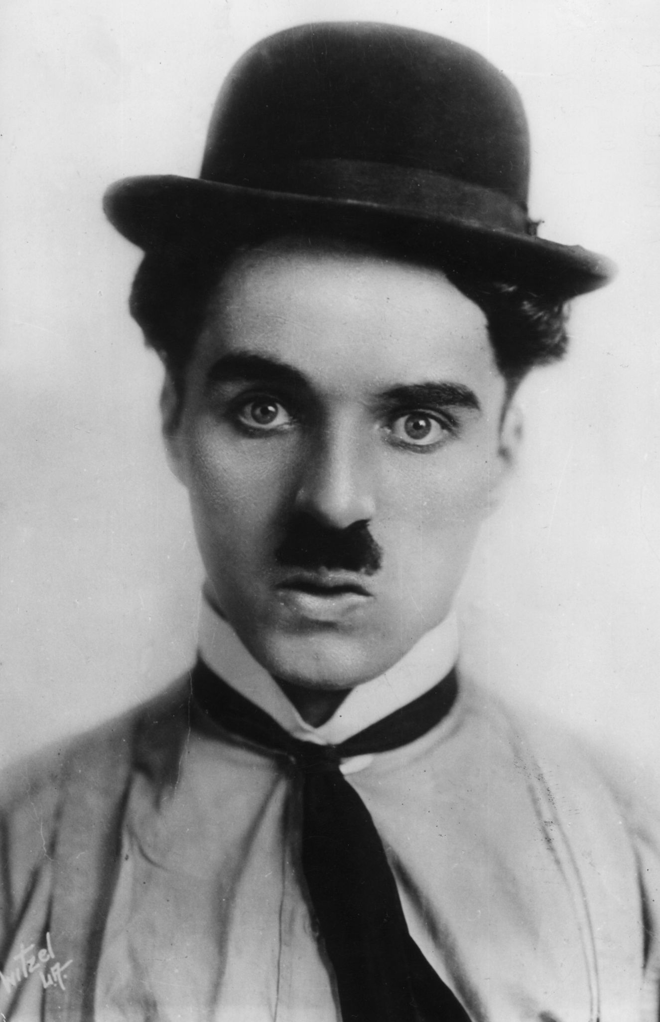
History of the Comedy films
Charlie Chaplin is well known for using comedy with his political views, which at the time was seen as radical and later paid the price for this.
However, in the 60’s comedy took a new form, comedy became a commonplace for films to include sensitive social and cultural issues and was used to make particular statements about them.
This social and cultural subversiveness was carried into the 70’s, with films such as Catch-22 that communicated an anti-war message.
Eventually films extended beyond social and cultural aspects, and become into a form of parody.

Slide 3
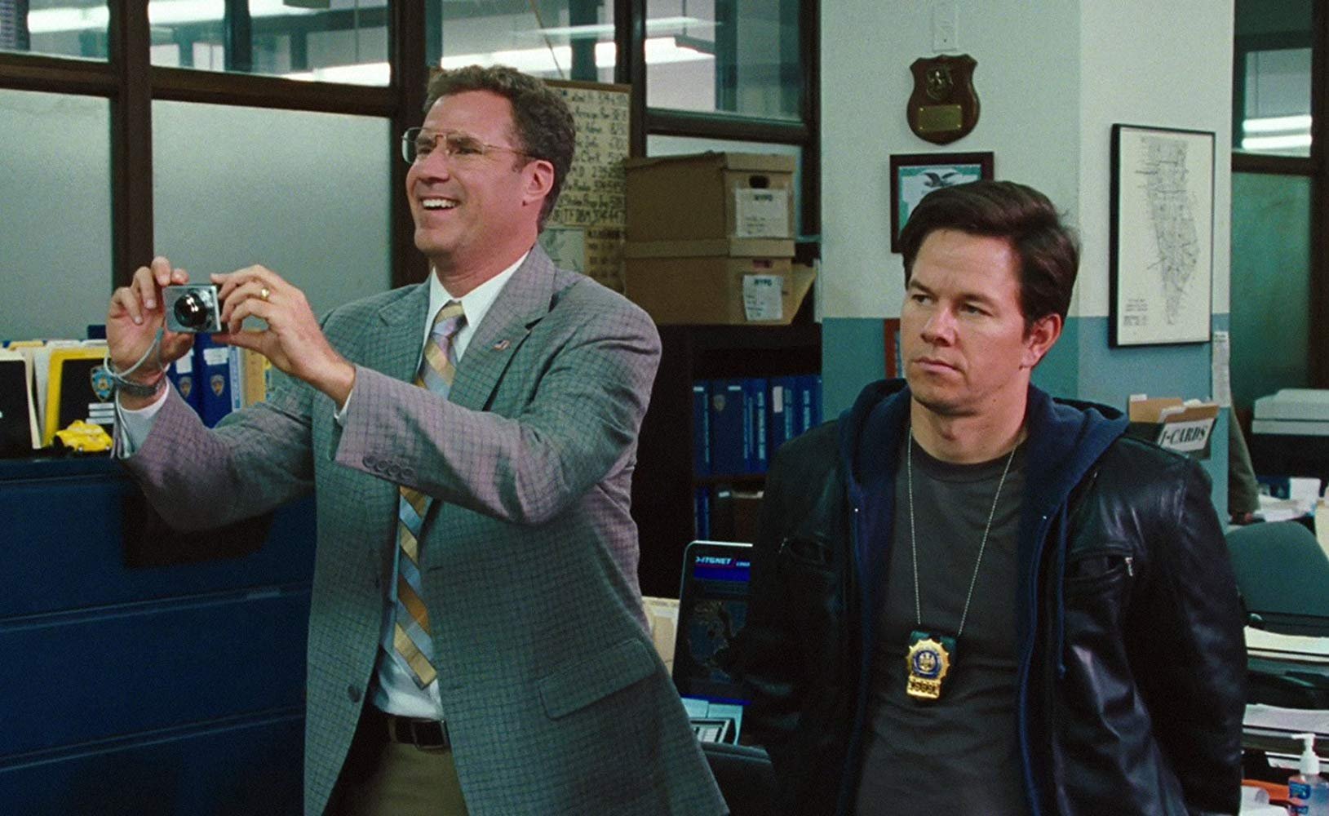
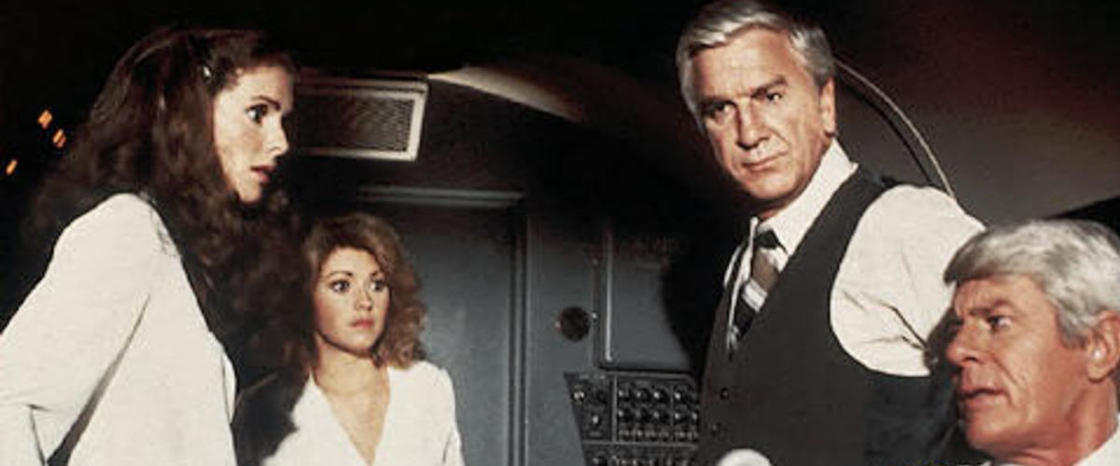
Sub-Genres of the Comedy film
Sub-genres of comedies include:
Parodies
Cringe comedy
Farce
Screwball comedy

Slide 4
Iconography of the Comedy film
Setting- Can be almost anywhere, most typical settings are suburban areas like highschools. They are often in sunny towns/ neighbourhoods
Technical Codes- There are often many establishing shots to show changed locations/ scenes.
Visual style- Light/ modern lighting, mostly natural lighting with high key highlighting main characters.

Slide 5
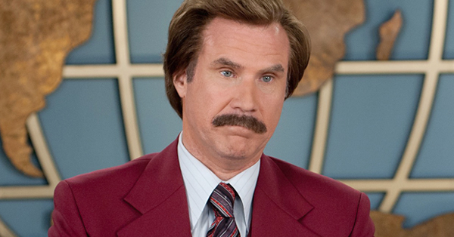
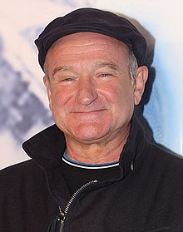
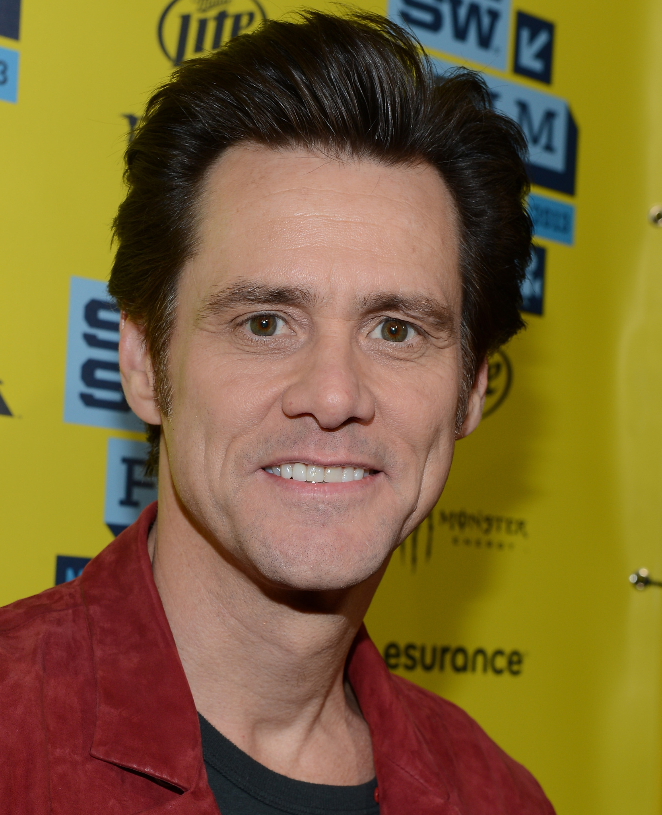
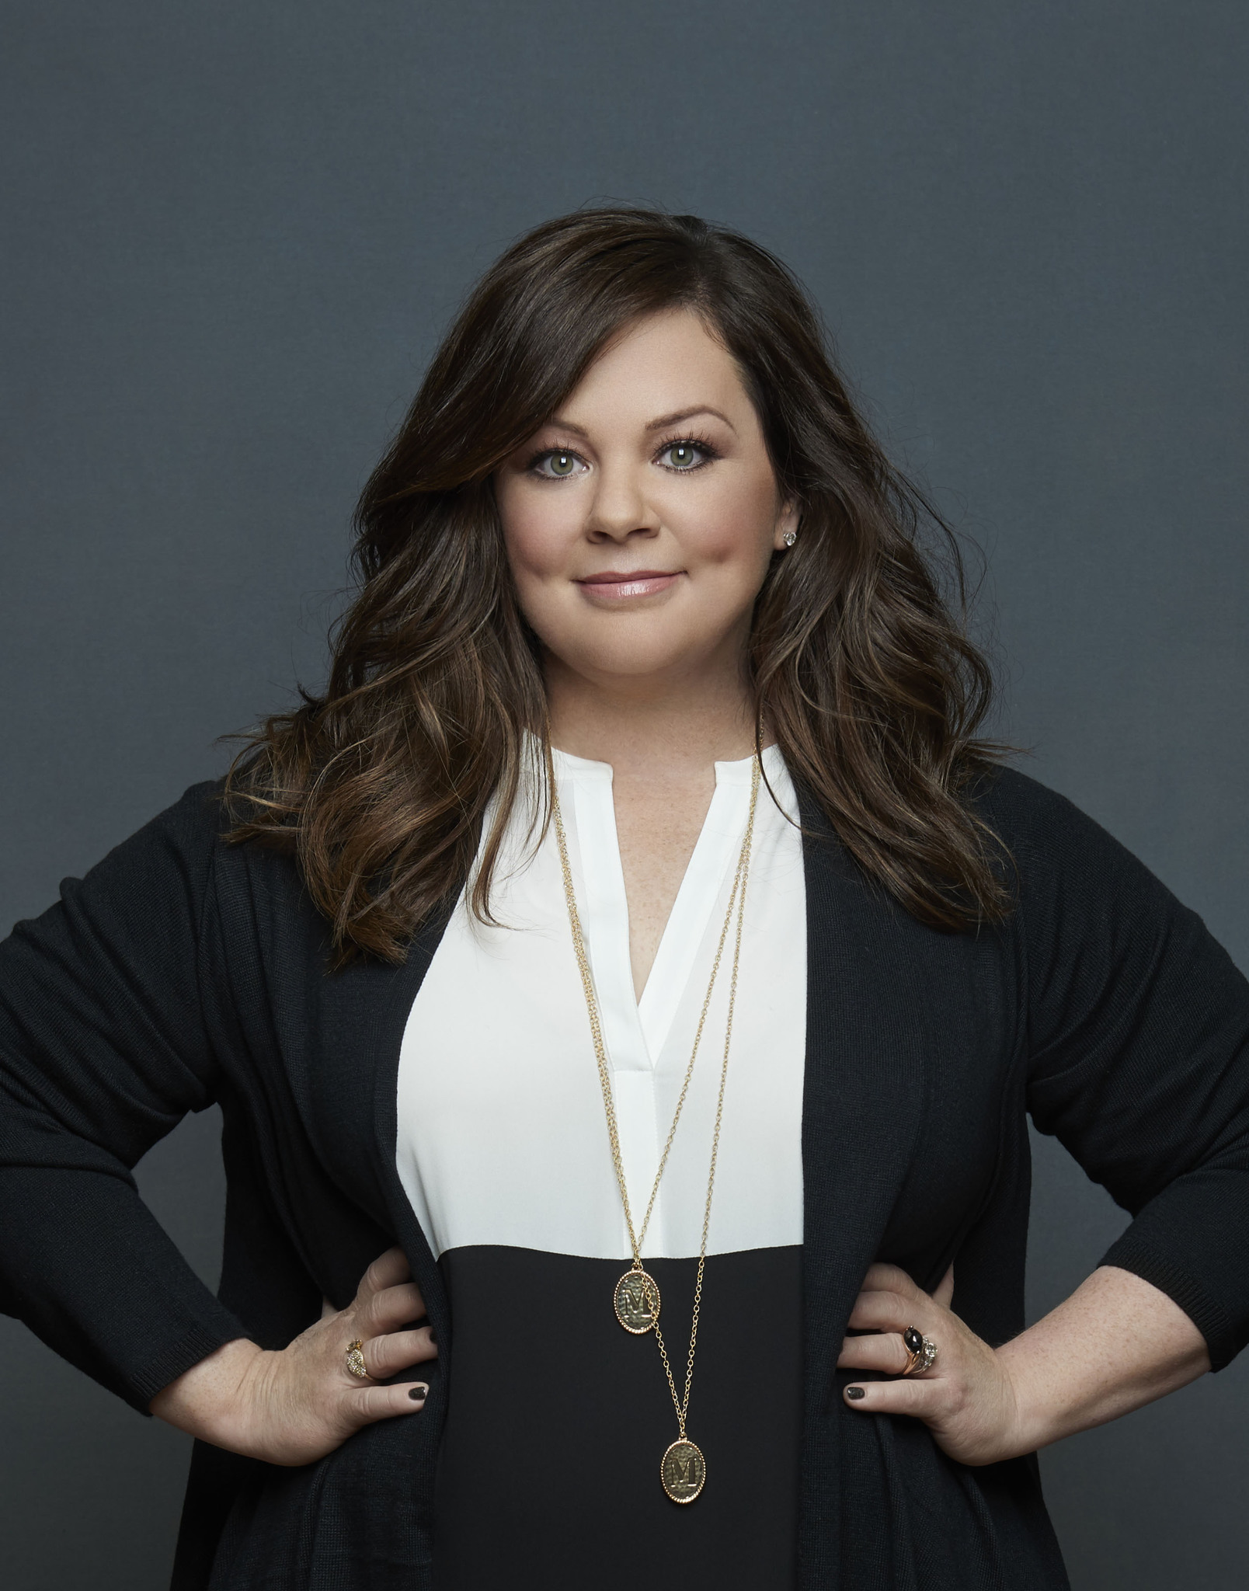
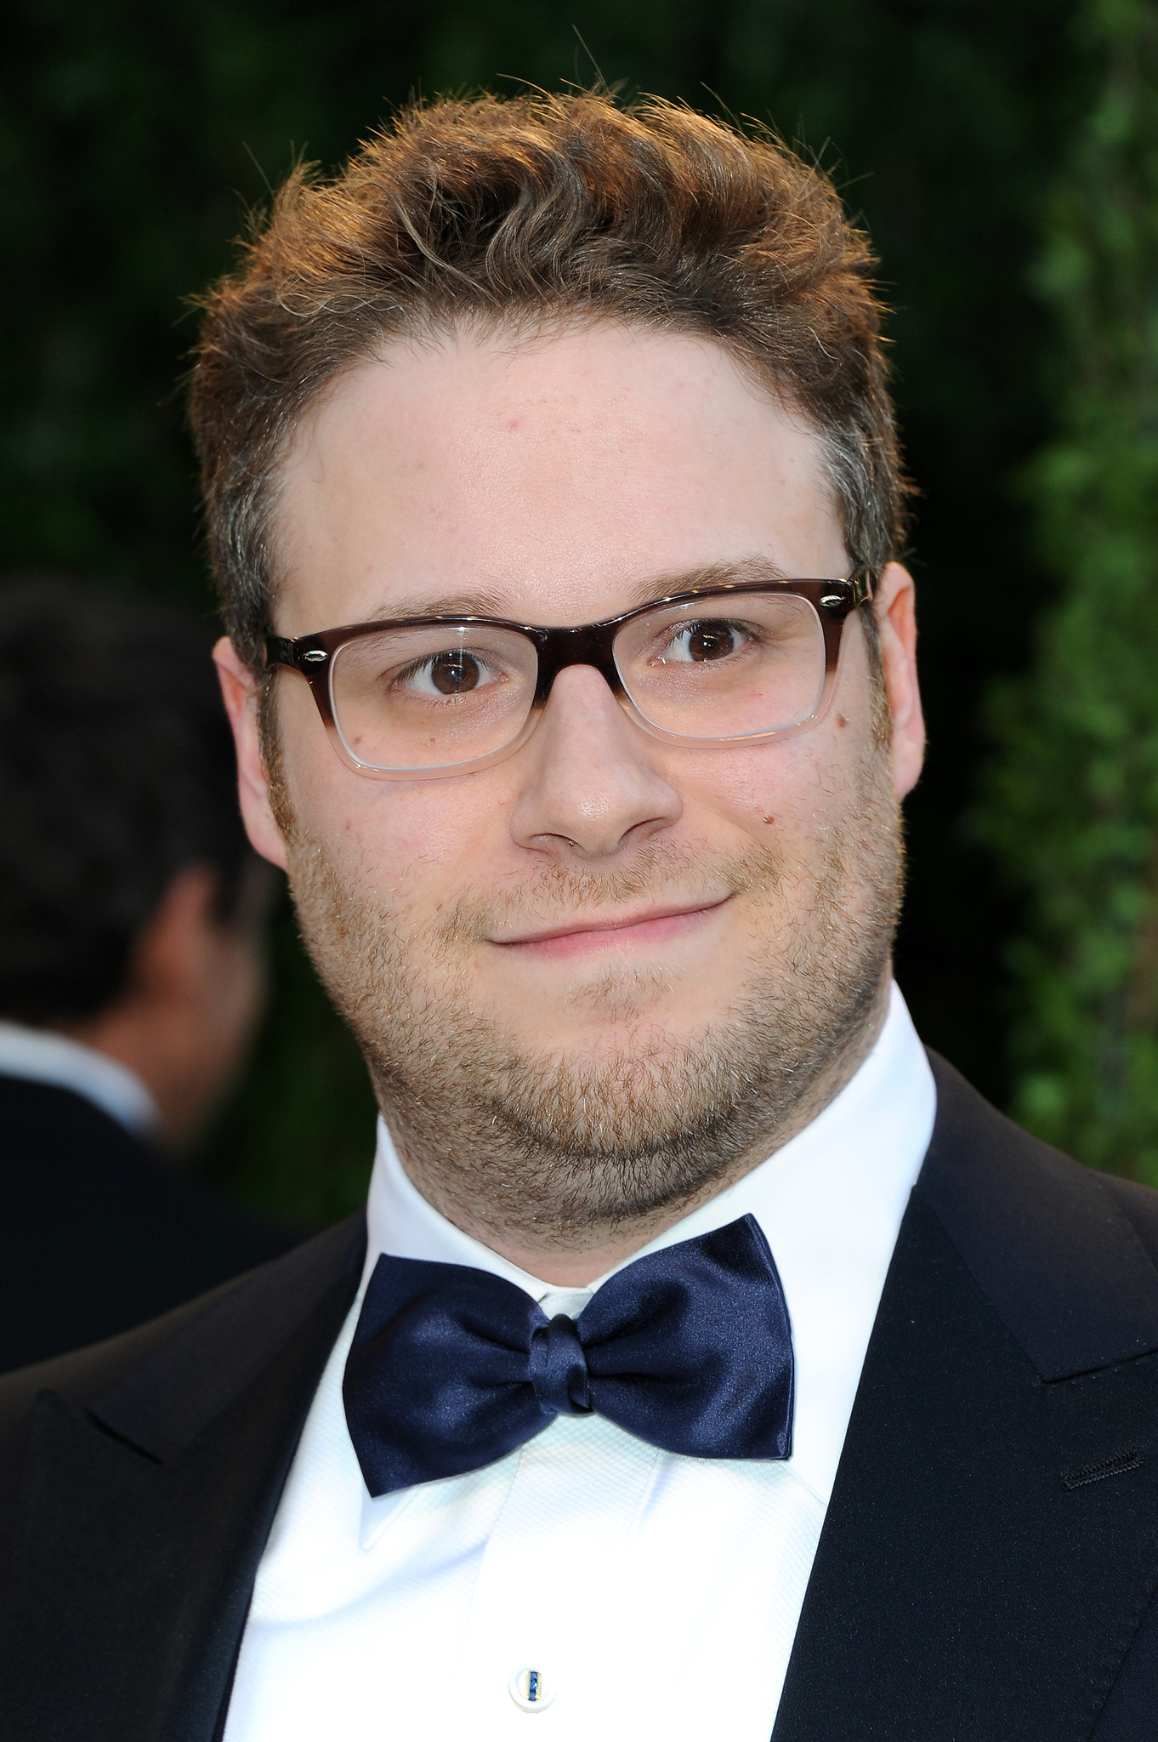
Actors/Directors associated with Comedy films
Will Ferrell
Robin Williams
Jim Carrey
Melissa McCarthy
Seth Rogen

Slide 6
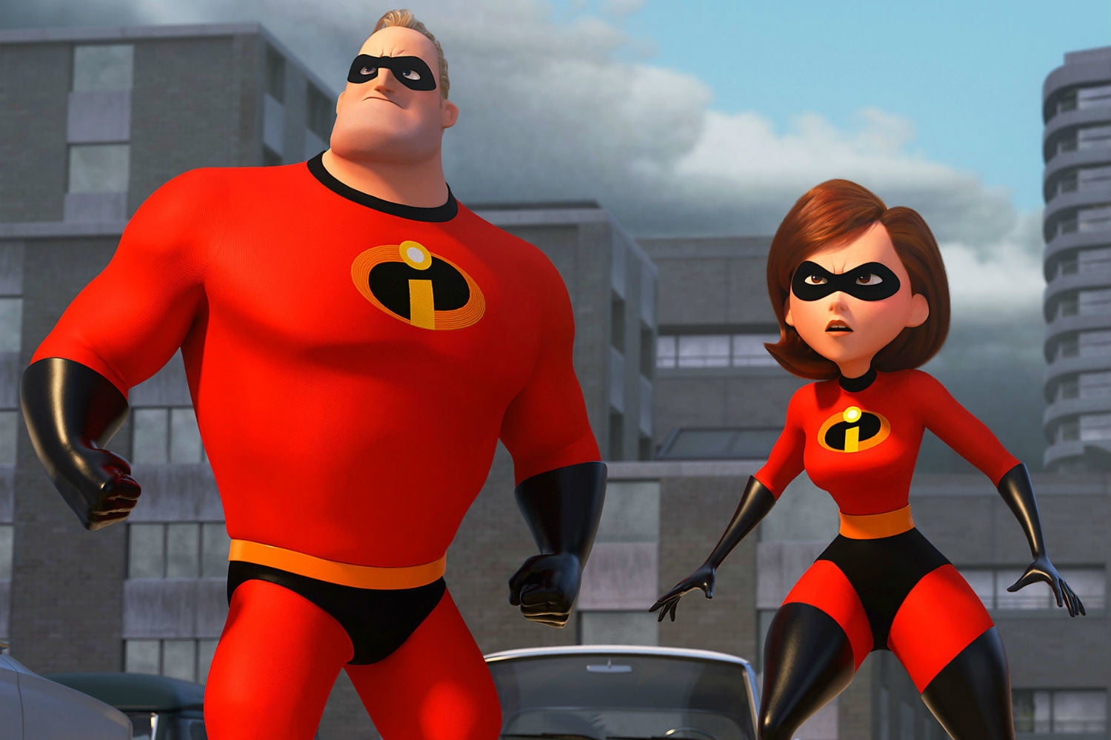
Box Office – Top films of the Genre
Highest rated Comedy films are:
Incredibles 2 (2018) $1.209 billion
Toy Story 3 (2010) $1.067 billion
Finding Dory (2016) $1.029 billion
Jumanji (2017) $962.1 million
Finding Nemo (2003) $940.3 million
Shrek: Forever After (2010) $752.6 million
Ghostbusters (1984) $610.6 million
Home Alone (1990) $581.1 million
Beverly Hills Cop (1984) $576.1 million
Blazing Saddles (1974) $542.5 million

Slide 7
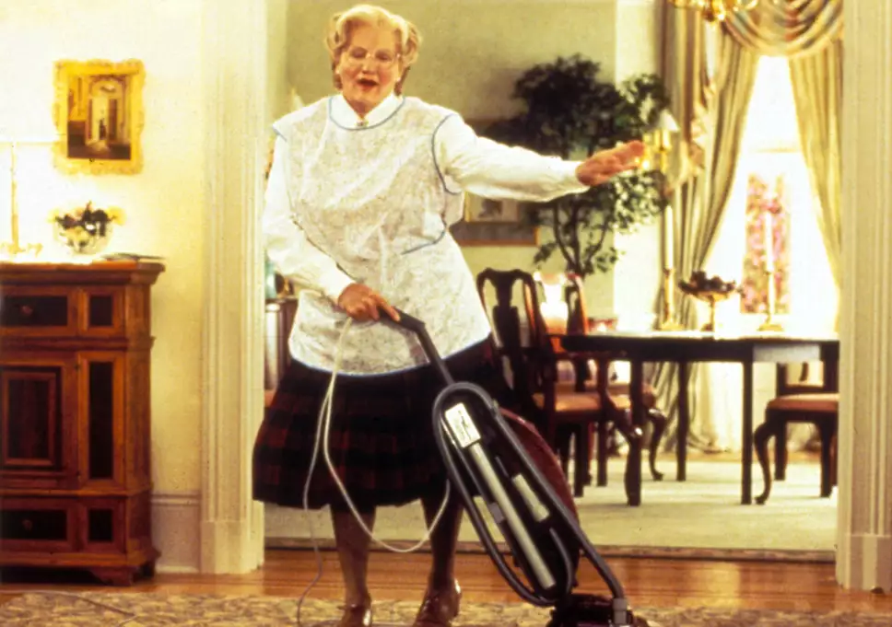
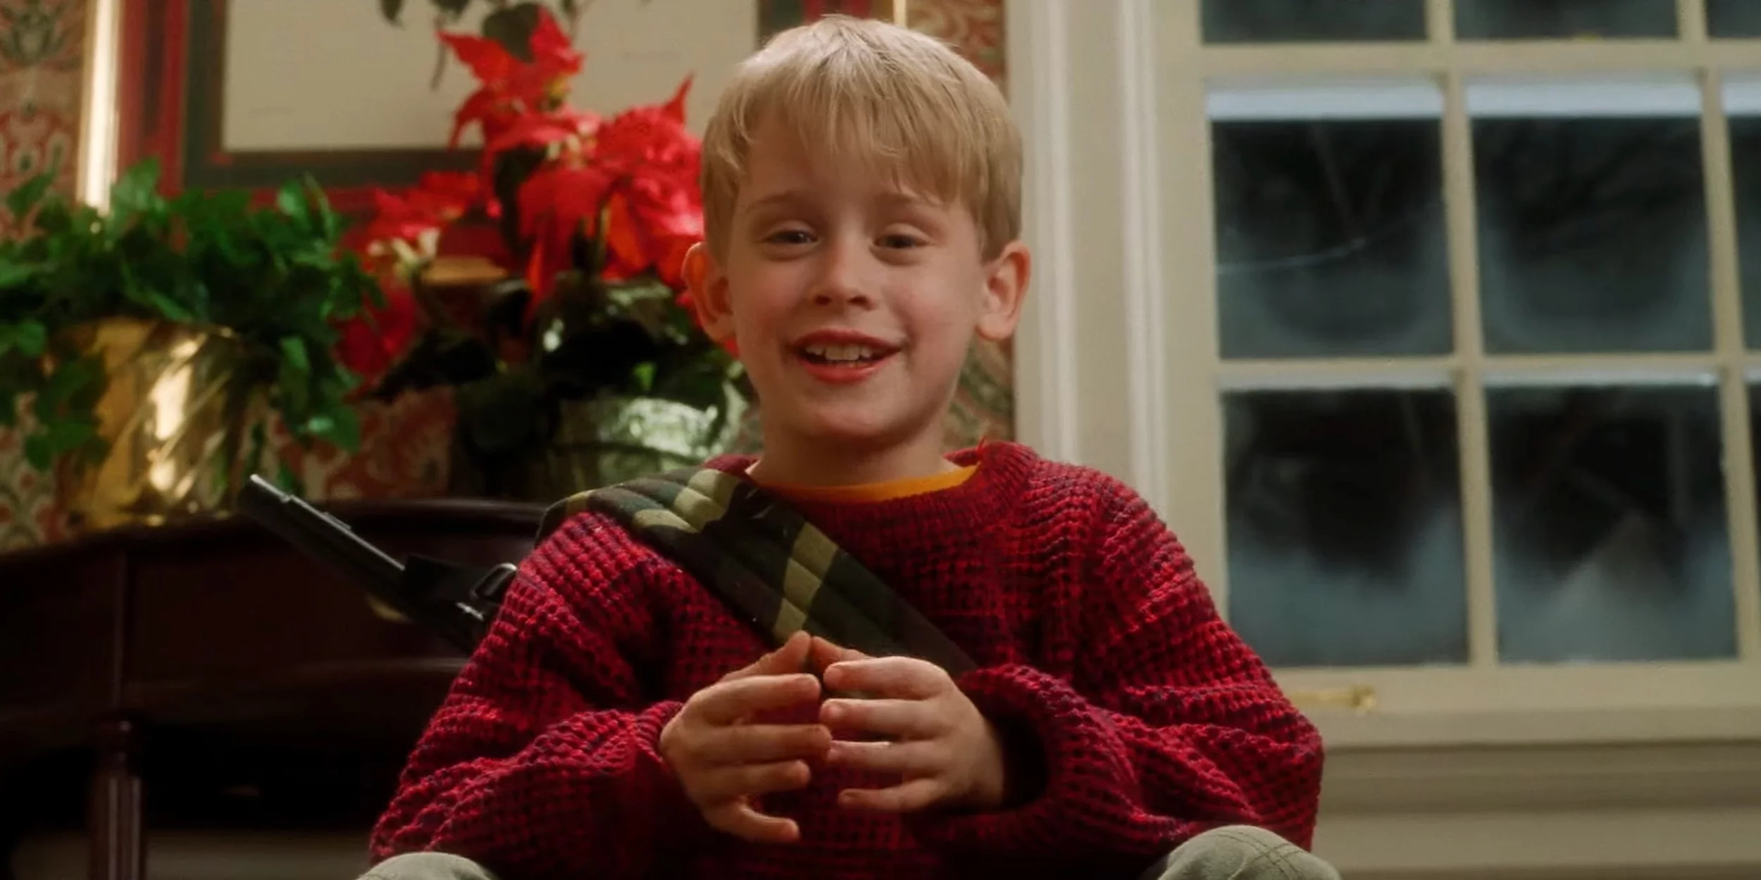
Budgets – Top films of the Genre
Mrs Doubtfire(1993) cost $25 million
Smokey and the Bandit(1977) cost $4.3 million
It’s a Mad, Mad, Mad, Mad world(1963) cost $9.4 million
Blazing Saddles(1974) cost $2.6 million
Home Alone(1990) cost $15 million

Slide 8
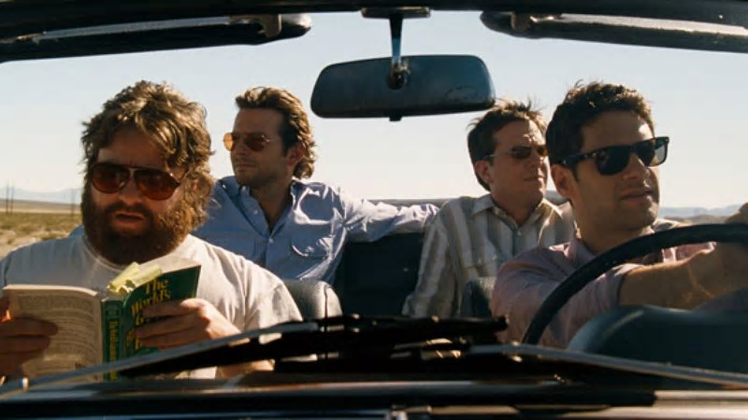
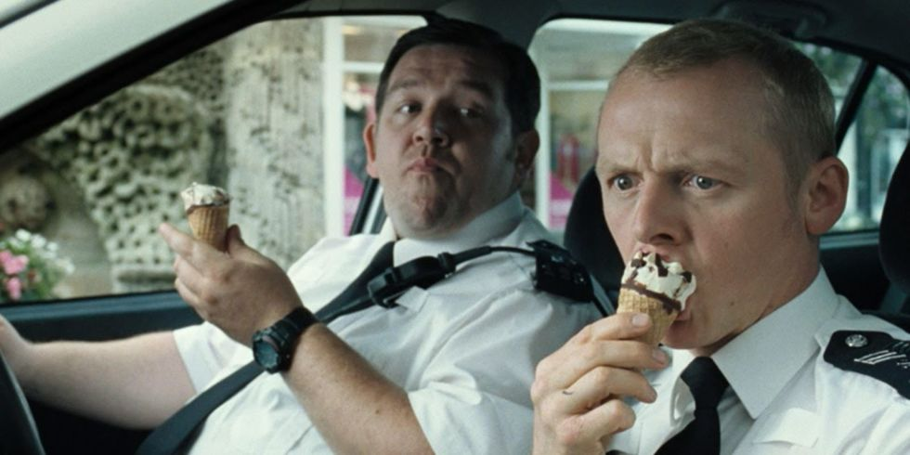
Critically acclaimed examples (according to IMDb)
The Hangover (2010)
The Lady Killers(1955)
Easy A(2010)
The Other Guys(2010)
Norbit(2007)
Don’t mess with The Zohan(2008)
Kick Ass(2010)
Yogi Bear(2010)
Brides Maids(2011)
Mrs. Doubtfire(1993)
Blazing Saddles(1974)
Hot Fuzz(2007)
Groundhog Day(1993)

Slide 9
Stretch and Challenge: Ideologies/Contexts

